Slide 1
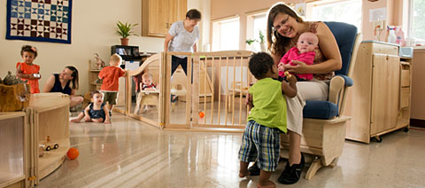
Responsive Caregiving in
Infant/ Toddler Programs:
The Key to Healthy Development
Cori Brownell & Candice Scott
Early Learning Specialists
The Research Institute at Western Oregon University
Notes:
Add trainer and/or conference/training specific information in the designated area.

Slide 2
Group Courtesies
Notes:
Encourage participants to share the behaviors which will help them learn while you’re together (“set phones to vibrate”, “limit side conversations”, etc.) Record their ideas on chart paper or a whiteboard. It may help to prompt their thinking with this statement: “All ideas are valid.”

Slide 3




Cori Brownell brownec@wou.edu
Candi Scott scottc@wou.edu
Notes:
This slide is meant as an “introduction” to you/your organization. Your name, job title, agency logos, etc. could be included on this slide.

Slide 4
Introductions
Share the following:
  Your name
  Program role and ages you work with
  What you love about your work
Notes:
A prompt for this slide could be “Because working with infants and toddlers can be overwhelming at times, we wanted to give you a moment to also focus on the rewarding parts of that work.” After a few minutes of discussion time in their groups, you can invite people to share some of what they love about working with infants and toddlers.

Slide 5

Outcome
Participants will develop a responsive caregiving program for infants and toddlers
Notes:
Explain that each participant has an agenda, notetaking PP packet, a training evaluation which they can fill out at the end of the training, and any other materials available to them. It may be helpful to acknowledge that “develop” may not be an accurate word to use here since they are likely already providing responsive caregiving. A more accurate outcome may be to “maintain and enhance providing a responsive caregiving program for infants and toddlers.

Slide 6
Objectives
Participants will examine foundational and current theories linking responsive caregiving and secure attachment to healthy brain development and positive child outcomes
Participants will explore practices critical in developing a responsive caregiving program for infants and toddlers and examine factors that may potentially interfere with building healthy adult-child relationships
Notes:
Invite volunteers to read each of the objectives out loud to the whole group.

Slide 7
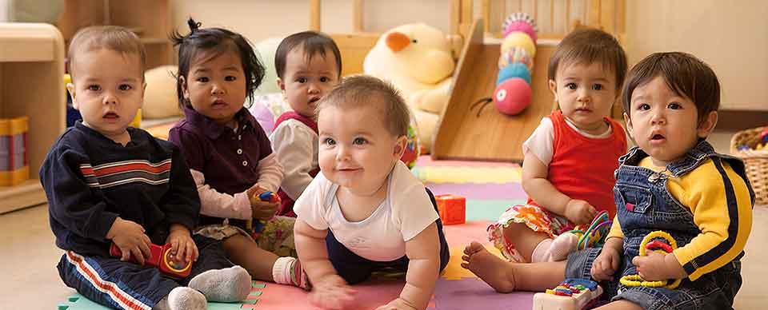
Objectives (continued)
Participants will examine, practice, and select strategies critical in developing a responsive caregiving program for infants and toddlers
Notes:
Remind participants that throughout the training, they will have the opportunity to reflect upon and share their ideas about their program’s practices.

Slide 8
Reflective Activity
Think back to your earliest memories. Describe at least two behaviors from adults in your life that shaped who you are today.
How did these caregiving behaviors affect your ability to form positive relationships, learn in school, and impact your work with children and families.
Optional sharing with group
Notes:
Participants can record their thinking on the PP notepages provided or on sticky notes. Depending on the group size and time available, participants may want to share in pairs or small groups with each other before the optional sharing with the whole group. You can choose to record the optional sharing responses on chart paper/a whiteboard or not.

Slide 9
Responsive caregiving is a key ingredient to healthy development of a young child’s relationships with the important people in his or her life, both within and outside the family. Relationships engage children in the human community in ways that help them define who they are, what they can become, and how and why they are important to other people.
(Center of the Developing Child, 2009)
Notes:
Have a participant read this quote. Ask participants which words or phrases stand out or resonate with them.

Slide 10
Responsive Caregiving
Supports children's social and emotional development
Creates nurturing and secure early care and learning environments
Collaborates with families to support children's growth and development
Notes:
What is responsive caregiving?

Slide 11
Goals of Responsive Caregiving
To build secure and healthy relationships
To empower children as effective communicators
To promote self-regulation
Notes:
This sets the stage for a future of healthy relationships and lifelong learning.

Slide 12
Foundational Theories Which Support Responsive Caregiving
Eric Erikson – Psychosocial
John Bowlby - Attachment
Magda Gerber - Respect
Bruce Perry – Trauma
Small Group Activity
Notes:
Share the handout with participants. You could choose to read through the handout as a group and discuss or give participants time to read it themselves and share ideas/ask questions about the content.

Slide 13

Healthy Brain Development
  http://developingchild.harvard.edu/index.php/key_concepts/toxic_stress_response/
The Impact of Stress on Brain Development
Notes:
https://youtu.be/VNNsN9IJkws Watch each video (first the Healthy Brain and then the Impact of Stress) and discuss how early experiences have lifelong implications on the developing brain.

Slide 14
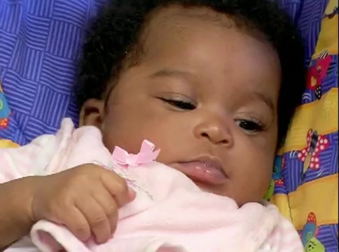
Still Face Video
Notes:
https://youtu.be/apzXGEbZht0
Have participants share in pairs, small groups, or each other what their thoughts are about the video and how it’s related to their work.

Slide 15
Critical Components of Responsive Caregiving
Adult child relationships
Routines and schedules
Cultural responsiveness
Relationships with families
Notes:
The next part of the training is broken down into the four critical components (read from slide) and focuses not just on what we can do to be responsive but HOW we can do it.

Slide 16
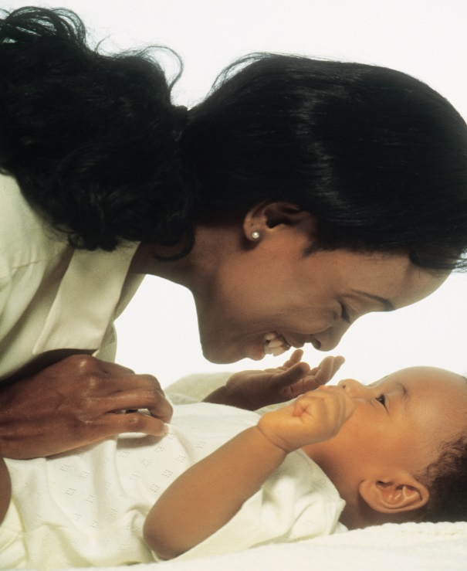
Adult-Child Interactions

Slide 17

Adult-Child Relationships
Acknowledge each child’s unique characteristics and family culture
Respond sensitively to cues and behaviors
Tune into feelings and empathize
Form a trusting relationship
Notes:
Brief description…dive deeper into each of the top 3 areas during this part of the presentation.
All of the above leads to creating trusting and healthy relationships.

Slide 18
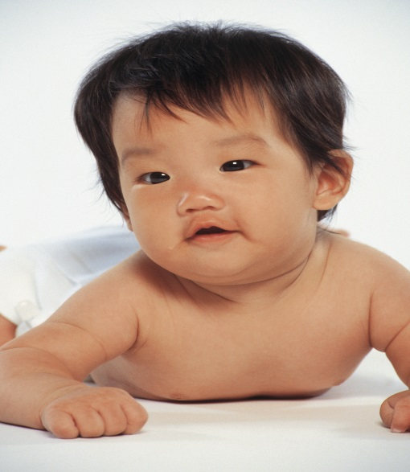
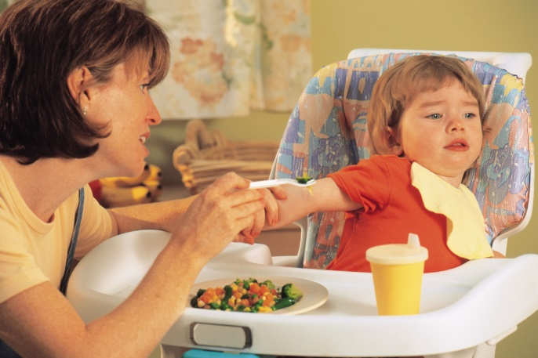
Reading the Cues
How do infants and toddlers communicate?
Engagement and disengagement cues
  crying, laughing, language
  facial expression, gaze
  gestures
Notes:
Because many cues are non-verbal and silent, it’s especially important to know where all children are and to check in with them often. Ask participants “What are the children in these photos communicating?”
Temperaments also affect adult-child relationships.
5 Areas- How we understand and respond to each child in the context of their temperament and ours.
Emotional intensity
Activity level
Frustration tolerance
Reaction to new people
Reaction to change
Let participants know about NCAST training

Slide 19
Responding to Cues
Observe
Evaluate
Respond
Adjust
Notes:
Magda Gerber’s advice is to “wait, wait, wait” to ensure you have time to evaluate before you respond.

Slide 20
Creating a Positive
Relational Climate
Consistent positive behavior
Frequent smiling and laughter
Respect
Clear absence of negative behavior
Notes:
Even occasional incidents of negative behavior compromise the adult-child relationship and can have lasting impact on children’s development.

Slide 21
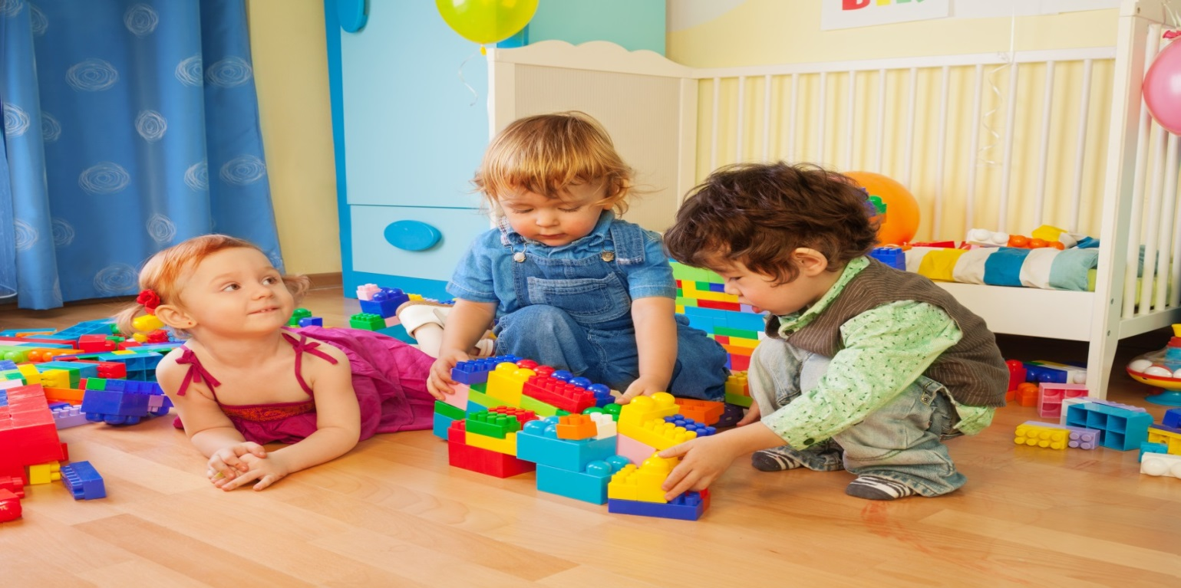
Routines and Schedules
Individualized
Unhurried
Predictable
Notes:
Routines:
They influence a child’s emotional, cognitive, and social development.
They help children feel secure and comfortable.
They help children understand the expectations of the environment.
They help reduce the frequency of behavior problems (e.g., tantrums).
They can result in higher rates of child engagement.
Play Time:
Increases children’s play behaviors and skills
Reduces negative behaviors like tantrums
Transitions:
Can be difficult, especially with multiple children
Plan for transitions

Slide 22
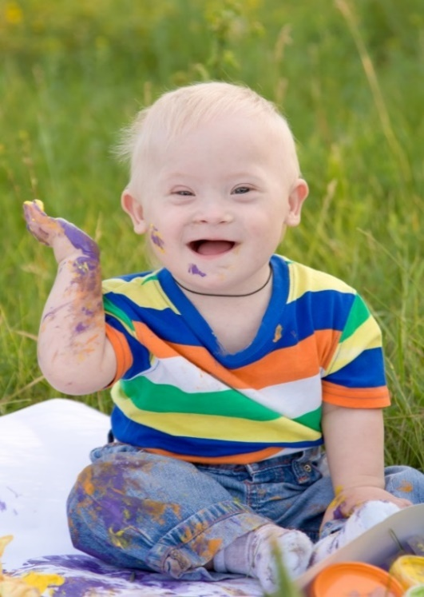
Facilitating Exploration
The environment is prepared
The child directs the experience
The caregiver extends the exploration
The schedule allows ample time
Notes:
Part of your everyday routines includes providing guidance by facilitating exploration. Make sure you attend to the bulleted practices.

Slide 23
Cultural Responsiveness
Create a climate that models respect, inclusion, and pride in all families’ cultures
Maintain an environment and implement caregiving practices that incorporate culturally and linguistically responsive methods
Provide opportunities for authentic conversations
Notes:
Commit to on-going training; educate yourself and your colleagues on inclusive practices and cultures of the families you serve.
Create an inclusive practices policy for your program.
Take time to meet with families and staff in groups and individually.
Ask questions! Reflect families’ cultures in the environment.

Slide 24
Relationships with Families
Communication
Respect
Collaboration
Flexibility
Notes:
You have a shared goal which relies on creating a partnership with your families: caring for and supporting the development of their children.

Slide 25
What Does This Look Like?
what babies need from caregivers

Slide 26
Small Group Activity
(Pair and Share)
Choose at least one scenario from the list or create your own.
Come up with an interaction that is NOT responsive to the child.
Come up with an interaction that IS responsive to the child.
Discuss the possible results from the interactions.
Notes:
Share activity handout. Have participants work with a partner to complete the activity. If time, have participants share some of their responses.

Slide 27
Challenges at the Program Level
Lack of support
Lack of resources
Lack of professional development in infant and toddler development and culturally competent practices
Lack of a positive organizational climate
Notes:
What gets in the way of providing responsive caregiving? Here are some of the program level challenges. Think about how these might be addressed; share if you have ideas.

Slide 28
Self-Assessment
Complete the self-assessment
  Which practices do you feel good about?
Notes:
Distribute Self-Assessments; encourage staff who work in the same classrooms/programs to complete together if they want to.

Slide 29
Professional Action Plan
Identify your next steps
  What is a change you wish to make immediately?
  What do you see as a future goal?
  What challenges might you face?
  What resources do you have?
Notes:
Have participants complete their action plans (at the bottom of the self-assessment). They can share their ideas with other if there is time.

Slide 30

Evaluation
Notes:
First, ask if there are any closing questions or comments about what they learned or experienced during the training. Then encourage participants to give you honest and specific feedback on their evaluations.

Slide 31

Best Friends
Notes:
https://youtu.be/PN-MjUC4f9k
Thank participants for coming and being committed to providing responsive care to their children and families. Share the video as a sweet and humorous look at how even a dog can provide responsive care to a toddler.

