Slide 1
Portfolio Building:
Family Partnerships Standards
Date
Trainer’s Name
Contact info
Agency name
Notes:
Timing: Slides 1-9 should take about 30 minutes, including introductions and signing in.
Materials:
All participants should bring their Quality Improvement Plan to the training session.
Portfolios will also be helpful. Plan to have at least one sample portfolio available so that you can refer to the evidence required for each indicator.
Dry erase board or flip chart, markers
Samples of business planning forms,
Sample copies of program evaluation tools such as provider self-evaluation, FCCERS, BAS (see slide #21), a way for employees to evaluate the program
Introduce trainers,
Ask participants to introduce themselves
Optional: Ice breaker activity chosen by the trainer

Slide 2
Session Outcome and Objectives
Examine the QRIS Family Partnerships standards and apply the standards in your program
Discuss program-wide implementation of family partnership policies and procedures, while creating documentation for your QRIS portfolio.
Work toward completing the “Family Partnerships” portion of your QRIS Portfolio
Notes:
Read through the objectives, or ask a volunteer to read them aloud for the group.
Objectives:
Examine the QRIS Family Partnerships standards and apply the standards in your program
Discuss program-wide implementation of family partnership policies and procedures, while creating documentation for your QRIS portfolio.
Outcome: Work toward completing the “Family Partnerships” portion of your QRIS Portfolio

Slide 3
Reflection
How close are you to meeting the Family Partnerships Standards at your desired Star Level?
Notes:
This can be done as a large-group or individual reflection followed by discussion.
Invite participants to share the quality improvements they have already made, and the quality improvements they have in mind.
Consider:
focusing the conversation on participants’ confidence in their ability to make improvements
focusing the conversation on participants’ reasons for making particular improvements

Slide 4
Portfolio
Your chance to show off what your program does
Document your quality, including quality improvements
Required for a quality rating
Ratings are never final, you can resubmit as many times as you want
Notes:
Slides 4-9 have been cut and pasted from the IQT training. They are included here as a reminder of the process. Feel free to spend more time or less on them as needed by your group

Slide 5
Evidence
Evidence is meant to be a measurable indicator of the quality of a program
Pay careful attention to the type of evidence asked for in the portfolio
You may add supplemental evidence but do not omit any required evidence
Notes:
Slides 4-9 have been cut and pasted from the IQT training. They are included here as a reminder of the process. Feel free to spend more time or less on them as needed by your group

Slide 6
Evidence Example
Program policy, written procedure or guidelines
  Copy of program policy, procedure, guidelines, philosophy, code of ethics, rules, etc. from a program document such as a parent handbook or operator’s manual selected to clearly demonstrate criteria
Written description
  Description of an activity, approach or procedure which demonstrates the criteria. This can include: an experience which demonstrates the performance criteria, teaching strategy used, or the physical environment or room arrangement
How are they different? Why are they different?
Notes:
Slides 4-9 have been cut and pasted from the IQT training. They are included here as a reminder of the process. Feel free to spend more time or less on them as needed by your group
Pay special attention to this slide.
The difference lies in who is being addressed. A policy, procedure, or guideline is addressed to parents and/or staff. It is included in a parent and/or staff handbook. A written description is addressed to the QRIS Review team. It might not exist anywhere other than as portfolio evidence.

Slide 7
Portfolio Requirements
Some standards are classroom-specific
Programs with multiple classrooms need to submit evidence for each classroom
Some standards are age-specific
Programs with multiple age groups will need to submit evidence for each age group
Multiple licensing locations
Programs can choose whether to submit for one, some or all locations
Notes:
Slides 4-9 have been cut and pasted from the IQT training. They are included here as a reminder of the process. Feel free to spend more time or less on them as needed by your group

Slide 8
Portfolio Development and Submission Process
Compile evidence for star level — evidence must be provided for EVERY indicator
Place labeled evidence in portfolio using included instructions and evidence pages
Check box indicating evidence has been provided
Submit portfolio to the Teaching Research Institute for review
Don’t forget to look at the scoring guide to help you understand how your portfolio will be rated!
Notes:
Slides 4-9 have been cut and pasted from the IQT training. They are included here as a reminder of the process. Feel free to spend more time or less on them as needed by your group

Slide 9
Percentage Scoring – Minimum to Achieve Rating
 | Learning and Development | Health and Safety | Personnel Qualifications | Family Partnerships | Administration and Business Practices
Total number of standards by domain | 12 | 6 | 5 | 4 | 6
Total number of standards needed to pass each domain | 10 | 5 | 5 | 3 | 5
Remember, evidence must be submitted for each indicator.
Your portfolio will not pass the initial screening and move on to a review team if it is not complete!
Notes:
Slides 4-9 have been cut and pasted from the IQT training. They are included here as a reminder of the process. Feel free to spend more time or less on them as needed by your group

Slide 10
FP1: The program uses family input and feedback to guide program planning and policy decisions.
3 Star
4 Star
5 Star
Families attend family meetings and/or serve on advisory groups to provide input on program and policy decisions.
The program surveys families once a year in their preferred language and uses their input in making program and policy decisions.
The program collects information on an ongoing basis to make program and policy decisions, using email, suggestion box, notebooks, etc.
Notes:
Slides 10-14 should take about 30 minutes, including about 15 minutes for individual writing
Large group discussion
Read each indicator for the standard, or ask participants to read the indicators aloud.
Discuss the meaning and intent of the standard and the indicators.
Ask participants to share their thoughts about the standard.
Some participants may have strong feelings about FP1 in particular. They may be worried that the standard is asking them to give up control of their program to parents. Some providers feel that parents already make a lot of unreasonable and uninformed demands. Consider asking participants to think about how they would like to improve their relationships with parents.

Slide 11
Evidence
3 Star
4 Star
5 Star
Program policy for including families in program advisory groups or meetings.
QRIS Family Survey Score Sheet.
Average score of 3 or higher on question #1 on the QRIS Family Survey.
Written example of how the program responded to family input from the survey.
Written example of how the program responded to family input from information collected.
Written example of how the program responded to family input from meetings or advisory groups.
Notes:
Materials:
Sample copies of QRIS Family survey
Sample policy for including families in meetings and / or advisory groups (Optional)
Large Group Discussion
Briefly Discuss the evidence needed for this standard.

Slide 12
How can we implement this?
The program surveys families once a year in their preferred language and uses their input in making program and policy decisions.
1.
✓
2.
✓
3.
✓
Notes:
Materials:
Copies of the QRIS family survey and score summary sheet
Dry erase board / flip chart, markers
Large group discussion
Some participants may be hesitant to ask parents for input. Some may have experience with parents who expect all suggestions to be implemented (“if you weren’t going to use my suggestion, why did you ask?”). Ask participants to discuss ways to avoid this, and to think about what kind of input / suggestions they can ask for that would not be disruptive.
Additional questions:
How can participants ensure that they get at least a 50% response rate from parents?
How can participants make sure that they follow through with surveying parents at least once a year?
How can participants survey parents in their preferred language?
What changes have participants made in response to the QRIS family survey, or other input from families?
Write participants’ responses on dry erase board / flip chart and use them later in writing sample evidence (slide # 15).
Note:
If all participants plan to apply for a 3-star rating, you might decide to spend less time on slides 13 and 14.

Slide 13

How can we implement this?
The program collects information on an ongoing basis to make program and policy decisions, using email, suggestion box, notebooks, etc.
Notes:
Note:
If all participants plan to apply for a 3-star rating, you might decide to spend less time on slides 13 and 14.
Materials:
Copies of the QRIS family survey and score summary sheet
Dry erase board / flip chart, markers
Large group discussion
What information should you collect from parents?
Write participants’ responses on dry erase board / flip chart and use them later in writing sample evidence (slide # 15).

Slide 14

How can we implement this?
Families attend family meetings and/or serve on advisory groups to provide input on program and policy decisions.
Notes:
Note:
If all participants plan to apply for a 3-star rating, you might decide to spend less time on slides 13 and 14.
Materials:
Copies of the QRIS family survey and score summary sheet
Dry erase board / flip chart, markers
Large group discussion
How can participants ensure that they get at least a 50% response rate from parents?
How can participants make sure that they follow through with surveying parents at least once a year?
How can participants survey parents in their preferred language?
What changes have participants made in response to the QRIS family survey, or other input from families?
Write participants’ responses on dry erase board / flip chart and use them later in writing sample evidence (slide # 15).

Slide 15
Writing your description…
What will you do to remember to survey families once a year?
  What changes have you made in response to the family survey?
  What changes to do anticipate needing to make?
How do you collect information from families?
  How do you use information from families to guide program and policy decisions?
Do you offer opportunities for parents to attend meetings or participate in advisory groups?
Notes:
Materials
Dry erase board or flip-chart, markers
Large group collaboration
Work together to write a sample written example of responses to surveys / family input. You may need to do quite a bit of scaffolding here, depending on the participants’ needs. Stress the importance of writing in their own words about their own practices for their portfolio evidence.
Individual work (about 10-15 minutes)
Allow participants time to write or outline a rough draft of their own written example. Encourage collaboration / peer-to-peer help. In order to build participants’ ability to write independently for their portfolio, consider asking participants to “buddy up” or work in teams. They should ask you for help only if neither buddy can solve whatever problem they are having.
If time permits and there is interest, invite participants to share their work with the large group.

Slide 16
FP2: The program meets the individual needs of children through mutually respectful, two-way communication with families.
3 Star
4 Star
5 Star
The program provides forms and essential program information in a manner that is understandable to all families in the program, regardless of differences in language, literacy, or ability.
The program collects information from families upon enrollment and provides a method for communicating changes.
Families are consulted about their child’s interests and preferences, informed about their child’s progress, and encouraged to contribute to learning and development goals, at least once a year.
Notes:
Slides 16-21 should take about 30 minutes, including about 15 minutes for individual writing
Large group discussion
Read each indicator for the standard, or ask participants to read the indicators aloud.
Discuss the meaning and intent of the standard and the indicators.
Ask participants to share their thoughts about the standard.

Slide 17
Evidence
3 Star
4 Star
5 Star
Average score of 3 or higher on question #4 on the QRIS Family Survey.
Average score of 3 or higher on question #2 on the QRIS Family Survey.
Average score of 3 or higher on question #3 on the QRIS Family Survey.
Written description of how changes in family information are updated.
Program policy on how families contribute to child’s learning and development goals and share child interests at least once a year.
Program policy on connecting families to resources they may need to understand information.
Notes:
Materials:
Sample copies of QRIS Family survey
Sample policies for 4-star and 5-star indicators (Optional)
Large Group Discussion
Briefly Discuss the evidence needed for this standard.

Slide 18

How can we implement this?
The program collects information from families upon enrollment and provides a method for communicating changes.
Notes:
Materials:
Copies of the QRIS family survey and score summary sheet
Dry erase board / flip chart, markers
Sample family information forms (optional)
Large Group Discussion
What information do you collect at enrollment?
What information would be helpful to you in addition to what you already collect?
How do you make sure that you are informed when information changes?
Write participants’ responses on dry erase board / flip chart and use them later in writing sample evidence (slide # 21).
Note:
If all participants plan to apply for a 3-star rating, you might decide to spend less time on slides 19 and 20.

Slide 19

How can we implement this?
Families are consulted about their child’s interests and preferences, informed about their child’s progress, and encouraged to contribute to learning and development goals, at least once a year.
Notes:
Note:
If all participants plan to apply for a 3-star rating, you might decide to spend less time on slides 19 and 20.
Materials:
Copies of the QRIS family survey and score summary sheet
Dry erase board / flip chart, markers
Samples of forms or anecdotes about how programs communicate with parents
Large Group Discussion
How do you get information from families about their child’s preferences and interests?
1-on-1 meetings?
Informal conversations?
Interview at enrollment?
What information would be helpful to you in addition to what you already collect?
How do you share information with families and encourage them to contribute to learning goals?
Conferences?
Child portfolios?
Informal conversations?
What other information might you be able to share with parents?
Write participants’ responses on dry erase board / flip chart and use them later in writing sample evidence (slide # 21).

Slide 20

How can we implement this?
The program provides forms and essential program information in a manner that is understandable to all families in the program, regardless of differences in language, literacy, or ability.
Notes:
Note:
If all participants plan to apply for a 3-star rating, you might decide to spend less time on slides 19 and 20.
Materials:
Copies of the QRIS family survey and score summary sheet
Dry erase board / flip chart, markers
Samples of forms or anecdotes about how programs communicate with parents
Large Group Discussion
Participants may not feel that the parents in their program have any need for this kind of support. Ask them to think about how they would find out if a parent has difficulty with reading written communication, and what resources exist to help.
How do you make sure that all parents can understand communications from program?
What resources are available to help if you need this in the future?
Write participants’ responses on dry erase board / flip chart and use them later in writing sample evidence (slide # 21).

Slide 21
Writing your description…
What will you do to collect the information you need?
How will you make sure you are informed of any changes?
How do you encourage families to participate in ?
How do you share children’s learning
Notes:
Materials
Dry erase board or flip-chart, markers
Large group collaboration
Work together to write a sample written example. You may need to do quite a bit of scaffolding here, depending on the participants’ needs. Stress the importance of writing in their own words about their own practices for their portfolio evidence.
Individual work (about 15 minutes)
Allow participants time to write or outline a rough draft of their own written description and/or policies. Encourage collaboration / peer-to-peer help. In order to build participants’ ability to write independently for their portfolio, consider asking participants to “buddy up” or work in teams. They should ask you for help only if neither buddy can solve whatever problem they are having.
If time permits and there is interest, invite participants to share their work with the large group.

Slide 22
FP3: Families are encouraged to be regular and frequent participants in the program.
3 Star
4 Star
5 Star
The program encourages all families to visit and observe at any time.
The program learns about all families’ cultural backgrounds, traditions, beliefs, home language, and interests, and requests ideas and/or suggestions from families for activities.
The program encourages families to assist or lead in planning and conducting special activities to share their cultural backgrounds, traditions, beliefs, home language, interests, and abilities.
Notes:
Slides 22-27 should take about 30 minutes, including about 15 minutes for individual writing
Large group discussion
Read each indicator for the standard, or ask participants to read the indicators aloud.
Discuss the meaning and intent of the standard and the indicators.
Ask participants to share their thoughts about the standard.

Slide 23
Evidence
3 Star
4 Star
5 Star
Average score of 3 or higher on question #5 on the QRIS Family Survey.
Average score of 3 or higher on question #6 on the QRIS Family Survey.
Average score of 3 or higher on question #7 on the QRIS Family Survey.
Written example of an activity suggested or led by a family.
Notes:
Materials:
Sample copies of QRIS Family survey
Large Group Discussion
Briefly Discuss the evidence needed for this standard.

Slide 24
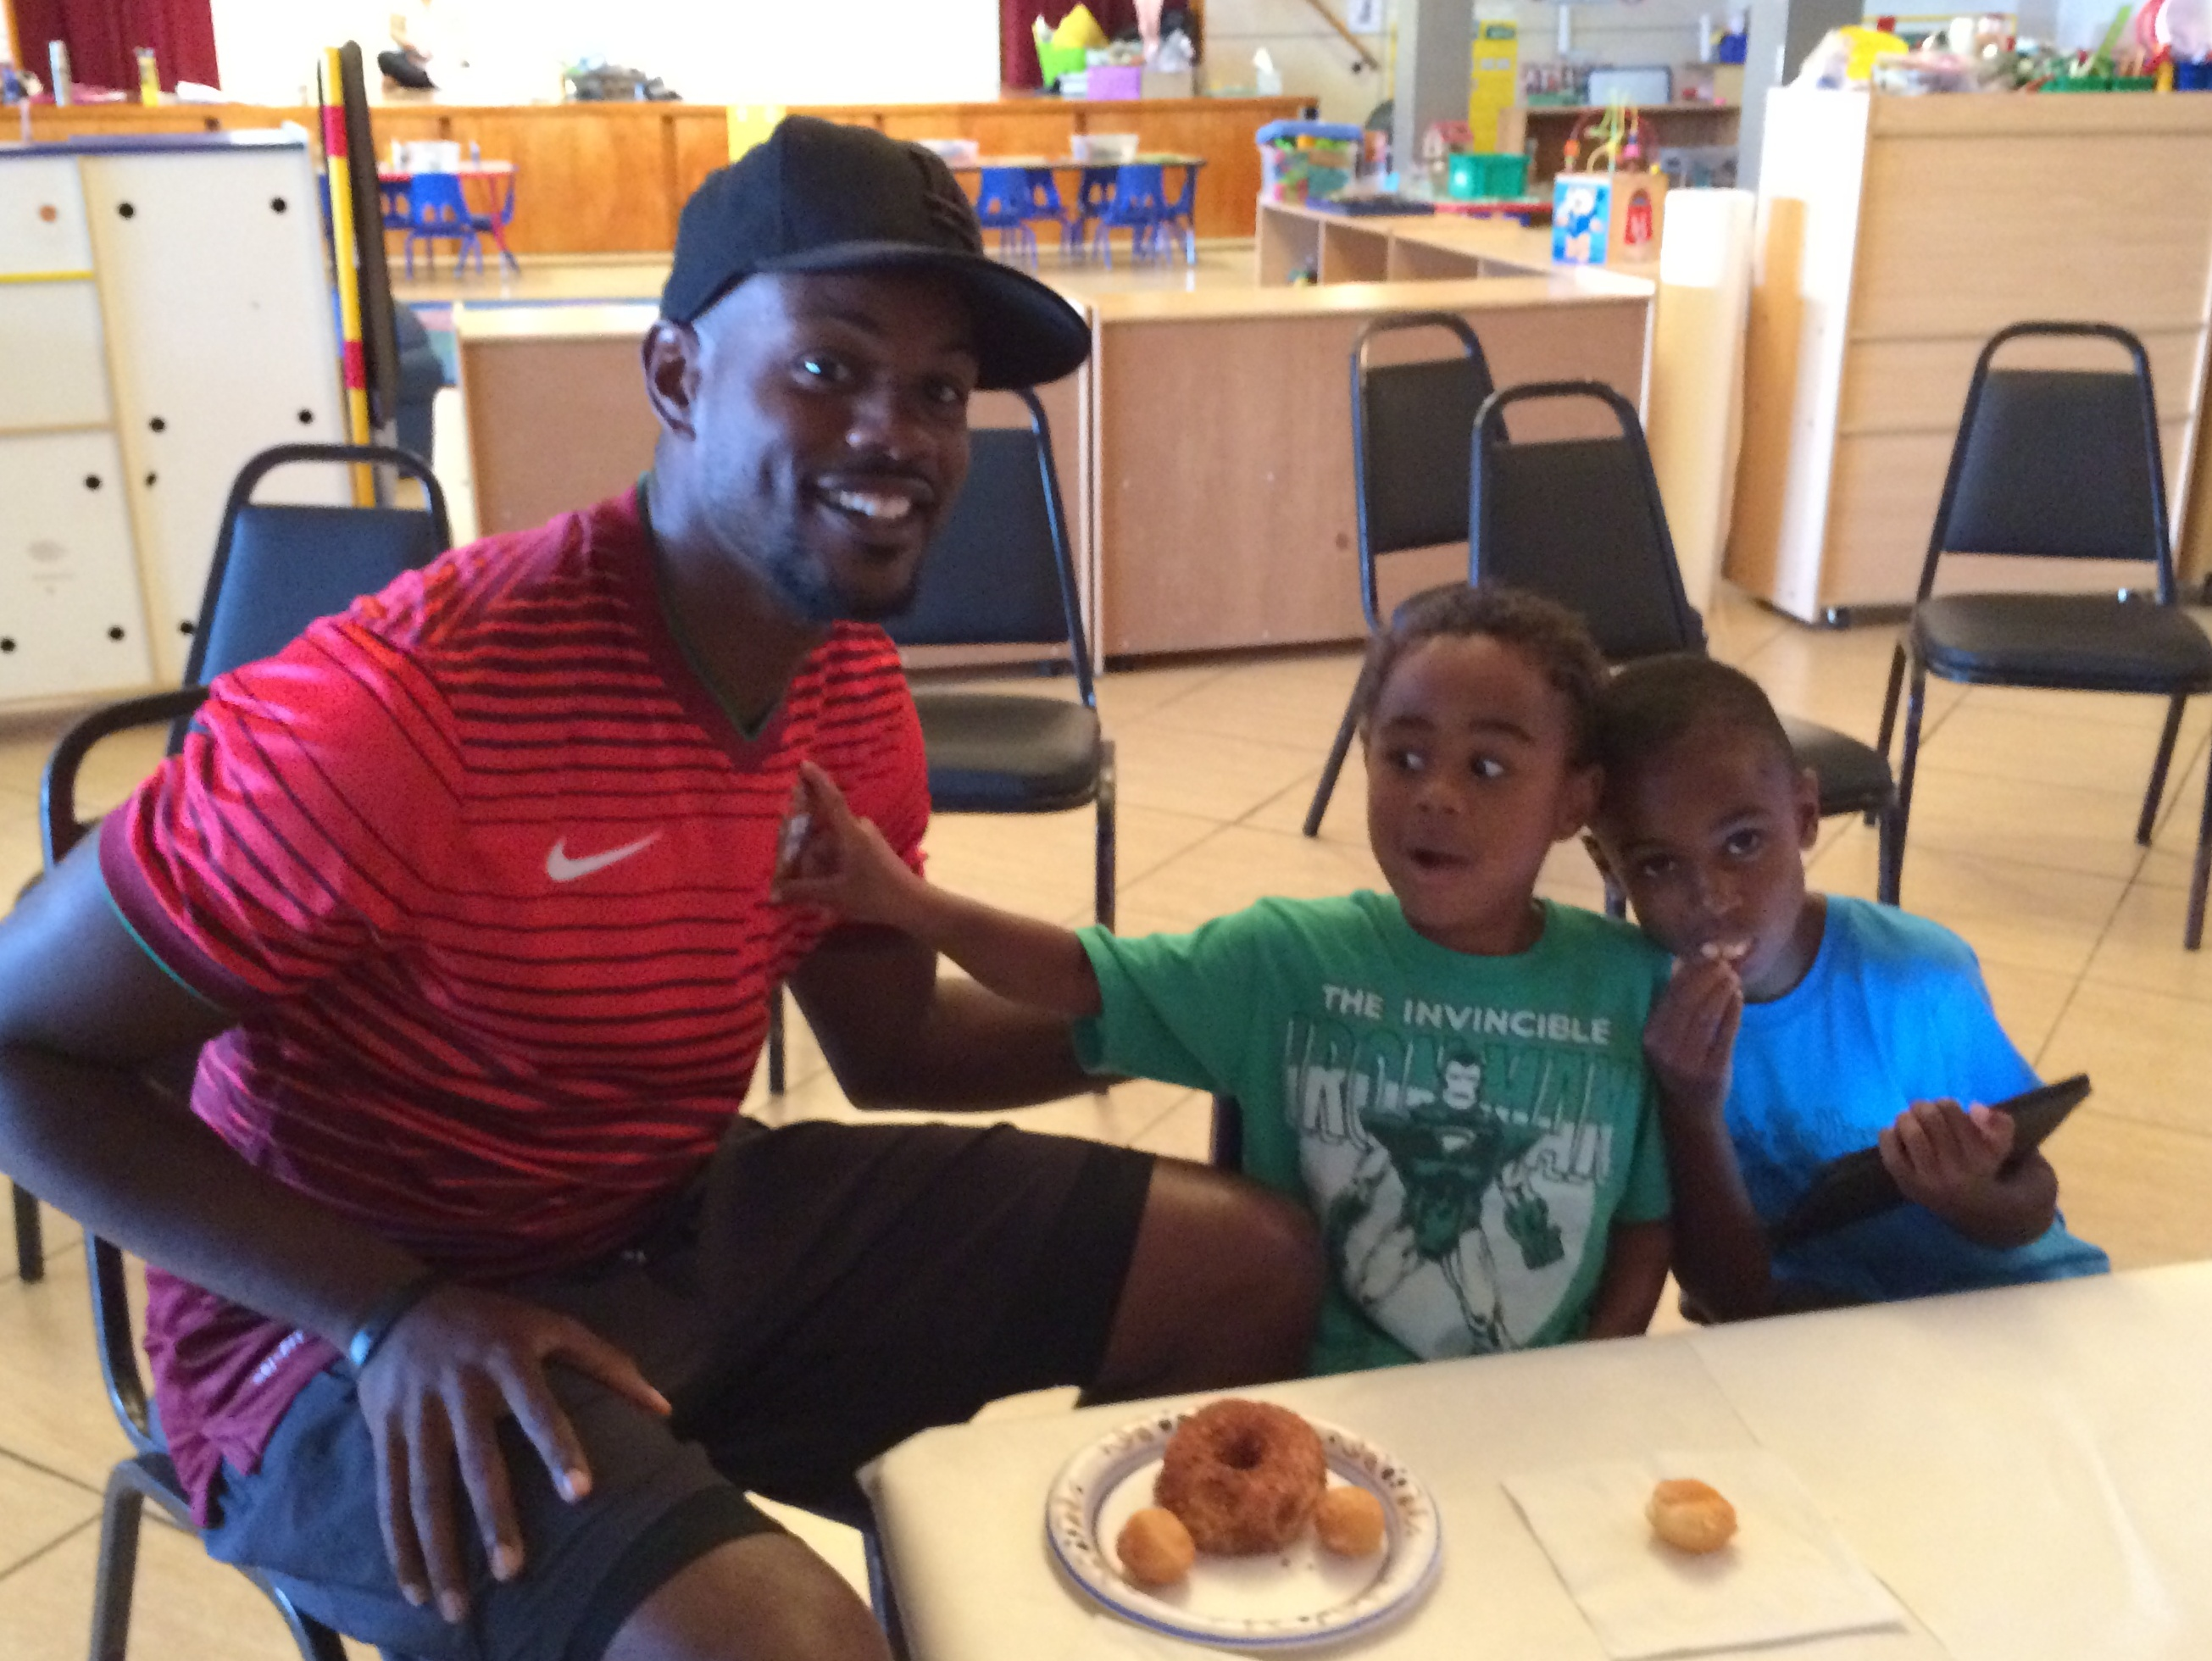
How can we implement this?
The program encourages all families to visit and observe at any time.
Notes:
Materials:
Copies of the QRIS family survey and score summary sheet
Dry erase board / flip chart, markers
“What you can do” handout (optional)
Large Group Discussion
Some participants may have strong feelings about allowing family members to visit at any time. They may feel that such visits would be disruptive to their program. They may feel that having parents visit at any time might make it difficult for children to feel comfortable in care. Some participants might benefit from deeper conversation (or further training) about how to support healthy parent/child attachment, and/or supporting the mental health of children who are fearful or have been exposed to trauma. Participants may benefit from technical assistance to help them coach parents on making visits go smoothly for their child.
Optional: The “What You Can Do” handout is a template for a letter that providers can use to communicate with parents about how they can visit their children during the child care day without causing unnecessary stress for their child. Ask participants to work together (in small groups or large group) to complete the sections that have been left blank.
Additional questions:
When are parents encouraged to visit?
How do you communicate your policy to parents?
Write participants’ responses on dry erase board / flip chart and use them later in writing sample evidence (slide # 27).
Note:
If all participants plan to apply for a 3-star rating, you might decide to spend less time on slides 25 and 26.

Slide 25

How can we implement this?
The program learns about all families’ cultural backgrounds, traditions, beliefs, home language, and interests, and requests ideas and/or suggestions from families for activities.
Notes:
Materials:
Copies of the QRIS family survey and score summary sheet
Dry erase board / flip chart, markers
Large Group Discussion
How do you learn about families culture, language, traditions, beliefs, etc.?
How do you avoid making assumptions about families (positive or negative assumptions based on experience with other families, prior learning, etc.)?
How do you (or how could you) request ideas and suggestions for activities from families?
What kinds of ideas / suggestions have families given you that were helpful?
Write participants’ responses on dry erase board / flip chart and use them later in writing sample evidence (slide # 27).
Note:
The photo of the Addams Family was chosen because we wanted to show a family whose culture, traditions, beliefs, interests, etc. are likely to be different from those of the participants, without stereotyping any group as being “different.” If training participants do not understand the reference, feel free to include a fun explanation. If you wish to change this (or any) picture to something that would be more culturally relevant, please feel free to do so.
If all participants plan to apply for a 3-star rating, you might decide to spend less time on slides 25 and 26.

Slide 26
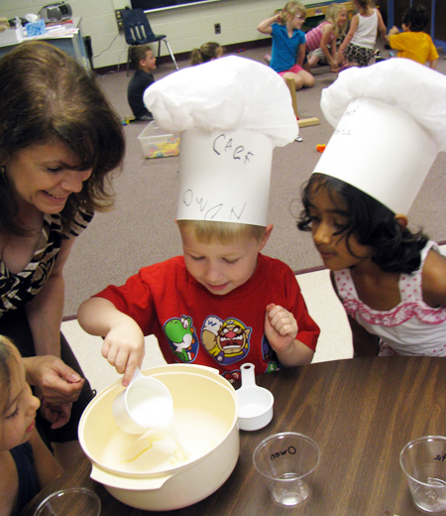
How can we implement this?
The program encourages families to assist or lead in planning and conducting special activities to share their cultural backgrounds, traditions, beliefs, home language, interests, and abilities.
Notes:
Materials:
Copies of the QRIS family survey and score summary sheet
Dry erase board / flip chart, markers
Large Group Discussion
How willing do you think parents will be to assist in planning or conducting activities? How can you encourage them?
What activities have parents planned or led in your program? How did it go?
What can you do to make such an experience as successful as possible?
Write participants’ responses on dry erase board / flip chart and use them later in writing sample evidence (slide # 27).
Note:
If all participants plan to apply for a 3-star rating, you might decide to spend less time on slides 25 and 26.

Slide 27
Writing your description…
What do you do (or will you do) to encourage families to visit?
What will you do to learn about families’ culture, traditions, beliefs, and language?
How will you ask families for suggestions regarding activities that reflect culture, etc.?
How might families be able to help plan or conduct activities to share their culture, traditions, beliefs, and language?
Notes:
Materials
Dry erase board or flip-chart, markers
Large group collaboration
Work together to write a sample written example. You may need to do quite a bit of scaffolding here, depending on the participants’ needs. Stress the importance of writing in their own words about their own practices for their portfolio evidence.
Individual work (about 15 minutes)
Allow participants time to write or outline a rough draft of their own written description and/or policies. Encourage collaboration / peer-to-peer help. In order to build participants’ ability to write independently for their portfolio, consider asking participants to “buddy up” or work in teams. They should ask you for help only if neither buddy can solve whatever problem they are having.
If time permits and there is interest, invite participants to share their work with the large group.

Slide 28
FP4: The program provides support and information to assist families in meeting their child’s needs and goals.
3 Star
4 Star
5 Star
The program provides current information for families about educational opportunities available in the community.
The program provides basic information about resources in the community, including those focusing on health, mental health, services for children with disabilities, and social services.
The program helps families to locate and use specific community resources as needed.
Notes:
Slides 28-33 should take about 30 minutes, including about 15 minutes for individual writing
Large group discussion
Read each indicator for the standard, or ask participants to read the indicators aloud.
Discuss the meaning and intent of the standard and the indicators.
Ask participants to share their thoughts about the standard.

Slide 29
Evidence
3 Star
4 Star
5 Star
Average score of 3 or higher on question #9 on the QRIS Family Survey.
Average score of 3 or higher on question #8 on the QRIS Family Survey.
Written example of providing assistance to families in accessing resources.
Copy of a newsletter or other communication that informs families about educational opportunities.
Notes:
Materials:
Sample copies of QRIS Family survey
Large Group Discussion
Briefly Discuss the evidence needed for this standard.

Slide 30






How can we implement this?
The program provides basic information about resources in the community, including those focusing on health, mental health, services for children with disabilities, and social services.
Notes:
Note: Please replace the images on this slide with local resources as needed.
Materials:
Copies of the QRIS family survey and score summary sheet
Dry erase board / flip chart, markers
Large Group Discussion
What resources exist in your community that address this standard?
How do you (or how could you) make sure parents know about them?
Write participants’ responses on dry erase board / flip chart and use them later in writing sample evidence (slide # 33).
Note:
If all participants plan to apply for a 3-star rating, you might decide to spend less time on slides 31 and 32.

Slide 31

How can we implement this?
The program helps families to locate and use specific community resources as needed.
Notes:
Materials:
Copies of the QRIS family survey and score summary sheet
Dry erase board / flip chart, markers
Large Group Discussion
What resources exist in your community that address this standard?
How do you (or how could you) find out when a family in your program needs these resources?
How do you (or how could you) make sure parents know about them?
Write participants’ responses on dry erase board / flip chart and use them later in writing sample evidence (slide # 33).
Note:
If all participants plan to apply for a 3-star rating, you might decide to spend less time on slides 31 and 32.

Slide 32





How can we implement this?
The program provides current information for families about educational opportunities available in the community.
Notes:
Note: Please replace the images on this slide with local resources as needed.
Materials:
Copies of the QRIS family survey and score summary sheet
Dry erase board / flip chart, markers
Large Group Discussion
What resources exist in your community that address this standard?
How do you (or how could you) make sure parents know about them?
Write participants’ responses on dry erase board / flip chart and use them later in writing sample evidence (slide # 33).
Note:
If all participants plan to apply for a 3-star rating, you might decide to spend less time on slides 31 and 32.

Slide 33
Writing your description…
What resources exist in your community?
  Health, mental health, children with disabilities, social services
  Educational opportunities
How can you share community resources with families?
How can you connect families with resources to address their specific needs?
Notes:
Materials
Dry erase board or flip-chart, markers
Large group collaboration
Work together to write a sample written example. You may need to do quite a bit of scaffolding here, depending on the participants’ needs. Stress the importance of writing in their own words about their own practices for their portfolio evidence.
Individual work (about 15 minutes)
Allow participants time to write or outline a rough draft of their own written description and/or policies. Encourage collaboration / peer-to-peer help. In order to build participants’ ability to write independently for their portfolio, consider asking participants to “buddy up” or work in teams. They should ask you for help only if neither buddy can solve whatever problem they are having.
If time permits and there is interest, invite participants to share their work with the large group.

Slide 34

Questions?

Slide 35
Thank you!
Portfolio Building:
Family Partnerships Standards
Evaluations
Certificates
Date
Trainer’s Name
Contact info
Agency name

