Slide 1

Spark Monthly Webinar
January 25, 2024

Slide 2
Welcome and Introductions
Ash Mickels (they/them), Spark Specialist, DELC
Spark Operations Team - TRI Center for Early Educator Support and Innovation
Debbie Gouger (she/her), Lead Administrative Project Specialist
ChienFei Huang (she/her), Bilingual Administrative Project Specialist
Marian Meaney (she/her), Bilingual Lead Project Specialist
Ivette Guevara (she/her), Bilingual Project Specialist
Mitch Bradner (he/him), Data and Database Specialist
Lauren Peterson (she/her), Center Director

Slide 3
What changed in 2023?
Code: 3131 6592
Notes:
https://www.menti.com/alqobu9j1rz8

Slide 4
Agenda
2023 – What Changed?
Spark Redesign progress
New participation options
FCCN
Observation and Assessment Team
2024 – What is ahead?
Spark Redesign
Review of QI report

Slide 5
Spark Redesign Progress
Winter 2023 - Selection of Community Wealth Partners as subcontractor to recruit and train the Listening and Design Teams
Spring 2023 - Selection and training of Listening and Design Teams
Summer 2023 Listening and Design Teams community outreach and development of Spark Redesign Recommendations
Fall 2023 - Spark Rated Programs Transition Team selection, community outreach, and development of recommendations; selection of Spark Accountability Team and beginning of recommendations for Spark design
Spark Website

Slide 6
Spark Accountability Team
sixteen members from the Listening and Design Teams and the Transition Team
comprised of early educators and parents from culturally, linguistically, and geographically diverse backgrounds from across the state
maintaining their role on this team for 1 to 2 years.
making recommendations for all “high level” aspects of the Spark redesign
TRI’s role is to provide resources, support, and facilitation
Notes:
Some of the AT members have been with this project since last spring.
They have all made a big commitment of time and effort to this process
Bio’s will be on the website next week

Slide 7
Spark Vision Statement
The vision of Spark is to be a welcoming and inclusive program that strives to connect all children and families in Oregon with great and responsive early education, development, and care, by supporting and celebrating providers.
La visión de Spark es ser un programa acogedor e inclusivo que se esfuerza por conectar a todos los niños en la temprana edad y familias de Oregón con una educación, desarrollo y atención de manera excelente y receptivo, apoyando y celebrando a los proveedores.
Предназначением работы проекта Spark является создание инклюзивной и доступной системы, стремящейся обеспечить ВСЕМ детям и семьям штата Орегон возможность для высококачественного и соответствующего потребностям каждого обучения, развития и ухода, а также поддерживающей и вдохновляющей провайдеров услуг.
Adopted by the Accountability Team by consent decision, December 7, 2023

Slide 8

Questions?

Slide 9
FCCN Participation
New participation guidelines
Updated Request for Funds form
tripayments@wou.edu for payment info

Slide 10
Questions?

Slide 11
Spark participation options
1. Spark Portfolio – available for programs that are listed with ERDC. (including resubmission for higher ratings).
2. QI Cycle – available for all programs, ERDC listed or not.

Slide 12
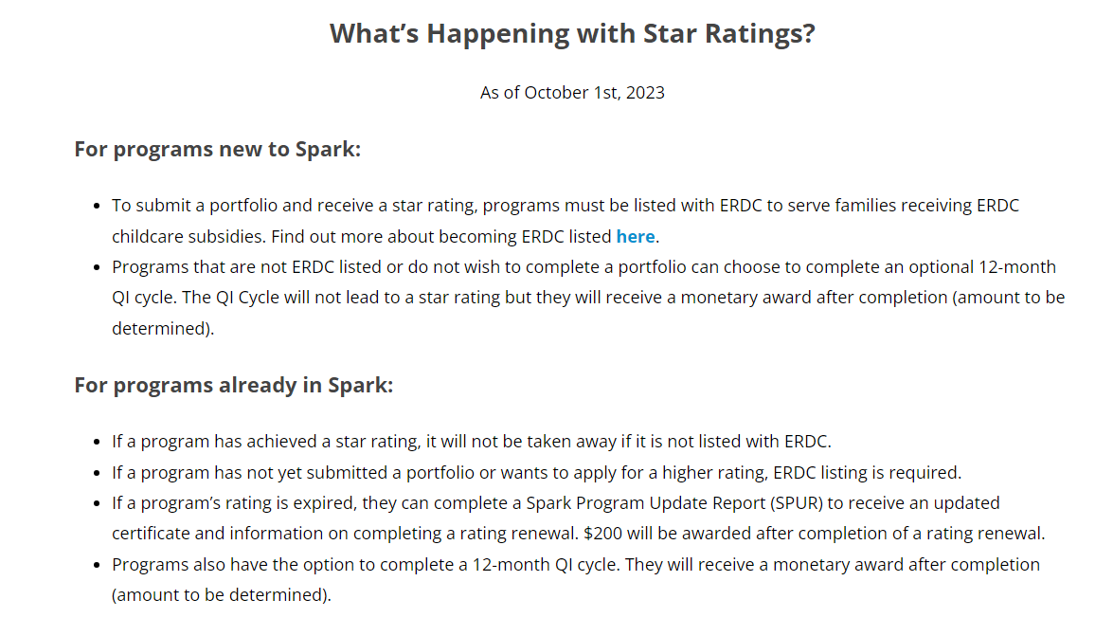
Website updates
Notes:
We had some rated programs expressed concerns that their ratings would be taken away if they were not ERDC listed, so we made some clarifications to the website.

Slide 13
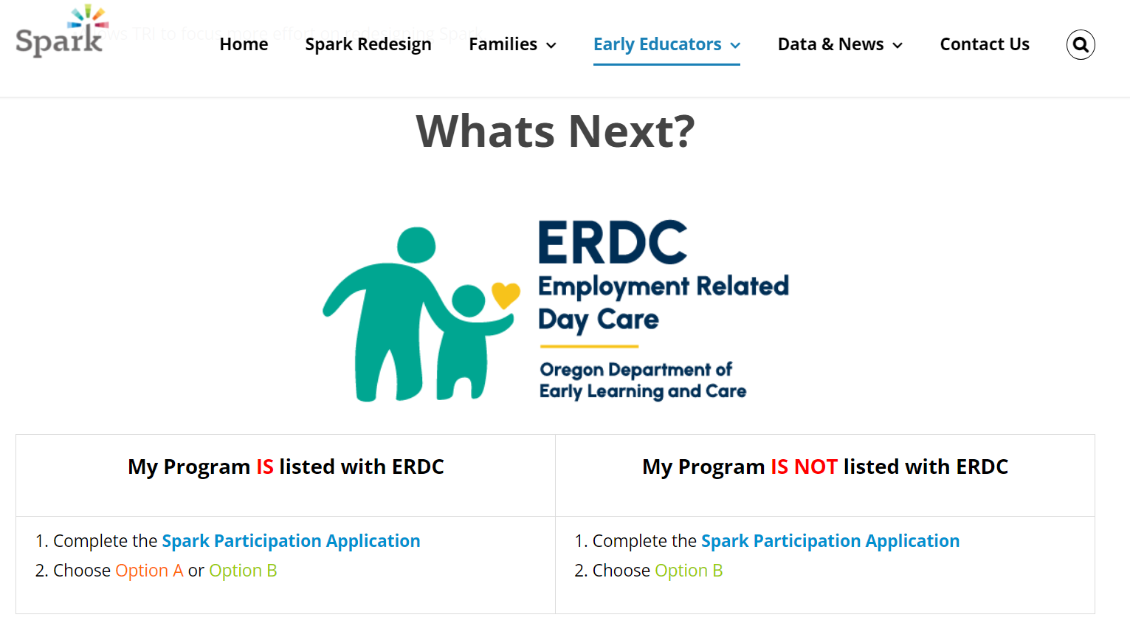
Website updates
Notes:
We wanted to make the options based on ERDC listing status more clear and clarify that ERDC listed programs could choose the QI cycle if they wanted to.

Slide 14
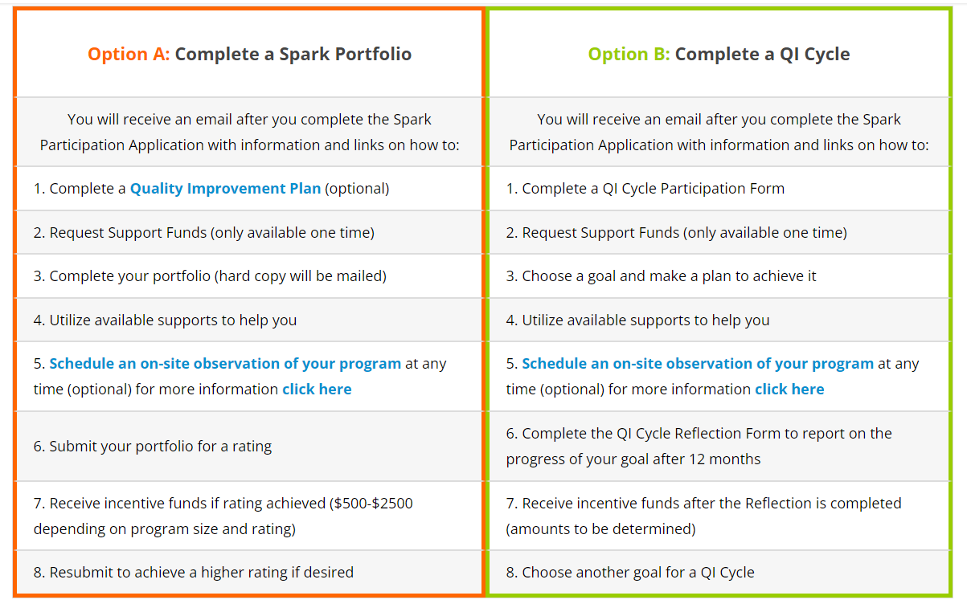
Website updates
Notes:
We didn’t make everything live links here because the starting point is completing a Spark Participation Application. The completion of the application is the trigger for receiving the information and links needed.

Slide 15
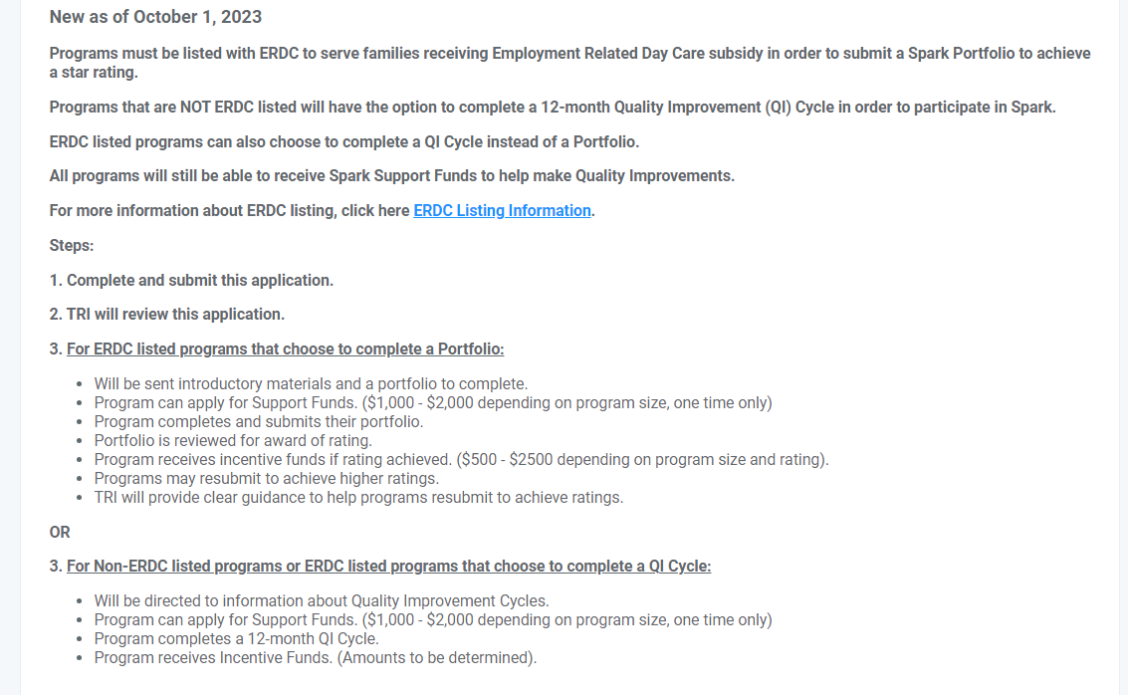
Spark Participation Application Updates
The pathways have been simplified on the Spark Participation Application.
Next steps for each listing status is explained.

Slide 16
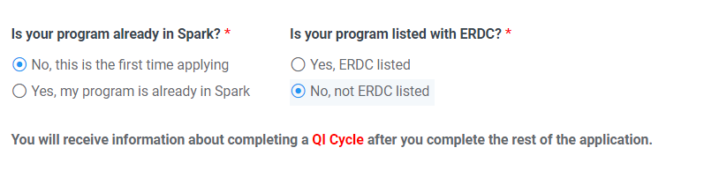
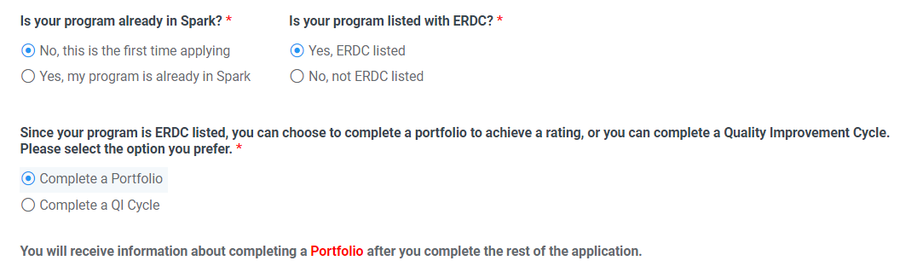
Spark Participation Application Updates
Not ERDC listed Message
ERDC listed choices
Notes:
We wanted to make it clear to programs what their options are and where they can make choices for their pathway.

Slide 17
Questions?

Slide 18
What is coming in 2024
Winter/Spring 2024
AT design recommendations
Supports/Incentives/Monetary grants recommendations
Summer 2024
Implementation Plan

Slide 19
Spark Accountability Team
The high level design concepts include:
Eligibility
Tiers
Framework
Measurement of improvement
Recognition
Evidence/Documentation
Information for families and family voice
Notes:
Who is eligible to participate
Tiers
CQI cycle framework (for example, the use of goal setting cycles, domains and standards, the use of badges or other quality indicators)
Process to measure improvement
Recognition (how will programs be recognized for their efforts
Information for families and inclusion of family voice (how will Spark help families find the best program for their children?)

Slide 20
Observation and Assessment Team
The Observation and Assessment has grown!
7 ½ Full time Assessment Specialists
1 ½ Project Support Specialists
2 Program Coordinators
Assessment Specialists are reliable in multiple tools including ECERS, FCCERS, ITERS, and CLASS PreK
Notes:
We encourage QIS participation and engagement in this reach out to your programs
Offering programs a short post obs debrief with program
QIS can reach out to programs if they want to be included in the debrief

Slide 21
QI reports
Mitchell Bradner, Data & Database Specialist
Purpose of report
How to read it
Questions?

Slide 22
Questions?

Slide 23
Help Desk

