Slide 1
Spark Redesign Convo
Ash Mickels (they/them)
Spark Specialist
Professional Learning System Office
Notes:
Update
Provide a guided conversation
Get prepared for what is coming next
Revisiting some of the why’s for redesigning – I believe it will help us
Understand the reasoning for the Spark Acct Team’s redesign proposal – why there are some fundamental shifts

Slide 2
Spark Redesign Stages
Driven by the leadership of families and early learning and care professionals
Statewide Engagement
Redesign
Spark
Implement Redesign
Assess
Redesign
3 Listening Teams
Team members: families and early learning and care professionals
Data: interviews, focus groups, & surveys
Presentations and Reports (from each team)
Accountability Team forms with volunteers from each listening team
Accountability Team creates formal Redesign Plan using data they collected (with TRI & DELC)
Spark Team @ TRI creates an Implementation Plan to launch Redesign Plan in phases
TRI launches newly redesigned Spark (upon DELC approval)
Accountability Team engages in ongoing process for assessing & improving Spark
Accountability Team creates and monitors Improvement Plan with TRI
March - November
October – June
June 2024 – June 2025
Ongoing

Slide 3
Accountability Team’s Vision for Spark
The vision of Spark is to be a welcoming and inclusive program that strives to connect all children and families in Oregon with great and responsive early education, development, and care, by supporting and celebrating providers.

Slide 4
Reconceptualizing Quality
Two of the recommendations:
Legitimate family and community expertise in defining quality ECE
Fundamentally reimagine the current system, moving toward co-creation of a quality system that is based on respect, trust and relationships; prioritizes self-determination for families and communities; is responsive to the needs of all communities; and ensures diverse representation in leadership.

Slide 5
Mindset Shift
According to Mitchell and colleagues:
“The courage to invite innovation…will require…reexamining our internalized beliefs and value judgments about what is “true” or “right” for children and families is likewise essential”(2024, p. 55).
My ask:
Notice what you’re feeling
Take time to reflect
Try to listen and understand why

Slide 6
Policy Equity Group
Knocking Down QRIS Structures and Rebuilding with Effectiveness and Equity at the Forefront
QRIS should be:
Predictive of child outcomes
Accurate measures of quality
Fair in expectations & supports
Notes:
https://youtu.be/A38-tnUA9eA?si=JMCf1IAE36-bVNbi

Slide 7
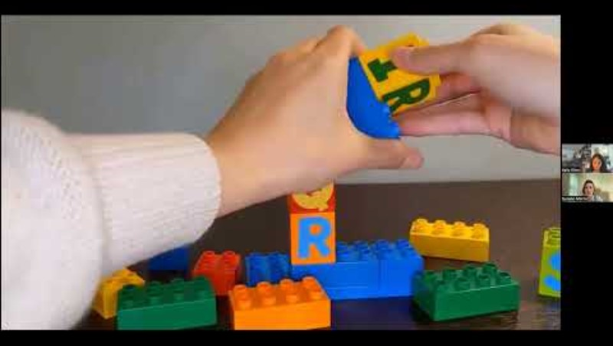
Overview + Individualism
Notes:
https://youtu.be/A38-tnUA9eA?si=oVL7NVLgfUnXE1xA&t=1122
Start at 18:42
Stop at: 24:44
(5 min)

Slide 8
Wows & Wonders
Notes:
Chat, unmute
(5-8min)

Slide 9
One “Right” Way
After the vignette we will go into breakout rooms and discuss the following questions:
Given Alma’s values, what might she think of the “quality” of Lauren’s classroom?
How might Alma be preparing her son for a world where having brown skin and interacting with authority figures can be dangerous?
What thoughts, judgments, or feelings did you notice come up for you as you listened to this vignette?

Slide 10
One “Right” Way
Notes:
https://youtu.be/A38-tnUA9eA?si=Y7tPlE8PNXK6W5qp&t=1484
Start at 24:44
Stop at 27:26
(3 min)

Slide 11
Breakout Rooms
Please discuss the following questions (10 min):
Given Alma’s values, what might she think of the “quality” of Lauren’s classroom?
How might Alma be preparing her son for a world where having brown skin and interacting with authority figures can be dangerous?
What thoughts, judgments, or feelings did you notice come up for you as you listened to this vignette?
Notes:
10 minutes

Slide 12
Paternalism
Notes:
https://youtu.be/A38-tnUA9eA?si=ywOO6H48kKXm2AwQ&t=1863
Start at 31:03
End: 38:53
(7 min)

Slide 13
Wows & Wonders
Notes:
Chat, unmute
(5-8min)

Slide 14
Current vs. Future Spark Proposal
Current Spark | Future Spark Proposal
One “right” way to define quality | Many “right” ways to define quality
Paternalism in ratings | Centering community wisdom & expertise
Individualism in financial supports | Equitable & ongoing support

Slide 15
Final Reflection Question: Hope
The vision of Spark is to be a welcoming and inclusive program that strives to connect all children and families in Oregon with great and responsive early education, development, and care, by supporting and celebrating providers.
In future Spark, how do you hope to make a positive difference in the lives of providers? What do you hope your role will be?
Notes:
Time?
Could this be a jamboard?

Slide 16




Mission
The Department of Early Learning and Care fosters coordinated, culturally appropriate, and family-centered services that recognize and respect the strengths and needs of all children, families, and early learning and care professionals.
Vision
All children, families, early care and education professionals, and communities are supported and empowered to thrive.
Values
Equity
We are committed to dismantling the systems of oppression that harm and create disparities for communities who are historically and institutionally excluded. We are adopting anti-racist principles, expanding access to services, and ensuring community representation and shared power in agency efforts. We are fostering a culturally responsive environment in which all individuals can experience a sense of belonging as they access programs, services, and resources.
Respect
We believe that family is a child's first teacher. We are committed to nurturing family partnerships built on mutual respect. We recognize and value the knowledge and experiences of families, early care and education professionals, and community partners.
Trust
We value the public’s trust through honesty, transparency, and keeping our commitments.
Relationships
We acknowledge the importance of nurturing relationships in the field and with community. We listen to, support, collaborate with, and celebrate the professionals, families, and children in our communities.
Safety
We put safety and well-being first for our children, families, and early learning and care professionals.
Continuous Improvement
We set goals, seek input from community, and use data to improve quality of service and programs, increase quality and efficiency, and drive innovation.
Integrity
We are accountable for our actions, decisions, and our work to reliably achieve high-quality outcomes.
Notes:
Empowered to thrive

