Slide 1
Spark June Webinar
Accountability Team
High Level Design Concepts
June 27, 2024
Notes:
Lauren (Remind everyone that the meeting will be recorded)

Slide 2
Welcome and Introductions
Spark Team
ChienFei Huang – Bilingual Administrative Project Specialist
Ivette Guevarra – Bilingual Project Specialist
Marina Meaney- Lead Bilingual Project Specialist
Lauren Peterson – Spark Program Director
Notes:
Lauren slides 1-6
what you are going to hear tonight is the result of 8 months of meetings, discussions with the AT
We are going to go through the concepts and have some time after for clarifying questions.
Save questions til the end
Reminder:
The presentation will be in both english and spanish. We will have two powerpoints running at the same time: spanish and english.
Remind folks to try and keep their cameras on
Offer tech support for those needing translation or learn how to switch from one language channel to another as we will have interpretation for both spanish and English
Guiding principles that emerged

Slide 3
Spark Accountability Team
Members
Scope of work
Recommendations*
  Shared with DELC on June 13th
  No approval or feedback from DELC until the end of summer
Notes:
Lauren what you are going to hear tonight is the result of 8 months of meetings, discussions with the AT
We are going to go through the concepts and have some time after for clarifying questions.
Save questions til the end
Reminder:
The presentation will be in both english and spanish. We will have two powerpoints running at the same time: spanish and english.
Remind folks to try and keep their cameras on
Offer tech support for those needing translation or learn how to switch from one language channel to another as we will have interpretation for both spanish and English
Guiding principles that emerged

Slide 4
Guiding Principles
  Spark will offer support without judgment to all participants.
  Spark will support early educators in finding/creating a community where feelings of belonging are nurtured, and values are shared.
  Spark will support and empower families to find care that aligns with the needs, values, and culture of their family.
  Spark will empower early educators to make choices about their Spark journey, offering options for goal setting and achievement, accessing resources and measuring progress.
  Spark will validate that early educators and families will define “quality” differently.
  Spark will ensure that participating programs have met basic health and safety standards and will communicate this to families.
Notes:
Lauren

Slide 5

Spark Vision Statement
The vision of Spark is to be a welcoming and inclusive program that strives to connect all children and families in Oregon with great and responsive early education, development, and care, by supporting and celebrating providers.

Slide 6
1. Eligibility
Notes:
Chien Fei slides 6-13
(At this time we will begin our presentation of the 7 concepts we have worked on. We will begin with Elegibility which will be presented by Maria and Tram… I would like to welcome Maria first who will be reading some quotes that we’ve gathered through this work from various community members, parents and participants from the listening groups, Transition team and the Accountability team. We will then move into recommendations and lastly rational before moving to the next concept and following a similar pattern)

Slide 7
Quotes
“I just want to be recognized and validated.”
“Prioritizing support. Tell us your story. We want you to be here, what do you want from us? What kind of support do you need?”
“Include every program that wants to be included. Spark can be a good way to describe what a program is like (universal language).”
“We need to limit barriers for folks to engage in participation throughout the entire process of the Spark system.”
“Open Spark’s door for everyone.”

Slide 8
Recommendations
All licensed and license-exempt* programs will be eligible to participate in Spark.
*Licensed exempt programs include all types of recorded, regulated subsidy programs, and all license exempt providers that are regularly working with children and would like to participate in Spark.

Slide 9
Rationale
The Spark vision is to be inclusive of as many programs as possible and support programs in providing the best possible early learning and care for children and families.
Spark will support early educators in finding/creating a community where feelings of belonging are nurtured and values are shared.

Slide 10
2. Tiers
Notes:
ChienFei through slide 13
I would like to now introduce the next concept which is Tiers

Slide 11
Quotes
“Let Oregon get away from a system based on judgment and move towards support and celebrating.”
“Prioritizing support. Tell us your story. We want you to be here, what do you want from us? What kind of support do you need?”
“Spark should be a way to show what I am now (starting points and basic criteria) and what is my path for growth (additional advanced opportunities).”
“Support without judgment- we aren’t going to rate programs. The engagement cycle would share the story and allow programs to measure their growth/success.”

Slide 12
Recommendations
Spark will be structured as a non-rated tiered system with an emphasis on support and recognition. Tiers will be based on the level of participation* and will offer different types of support** for programs.
*Tiers as a level of participation would consist of:
  Initial participation (when a program establishes/confirms its basic health and safety criteria are being met (see appendix) or uses its first engagement cycle to meet the requirement)
  Potentially one or several additional advanced tiers depending on the number of engagement cycles a program has completed.
** Different types of support mean intensified TA and access to Spark resources for initially meeting health and safety quality practices or other basic requirements (ORO account) on the first level and more detailed targeted support for establishing and achieving individual quality improvement goals on the next level(s).

Slide 13
Rationale
Spark will empower early educators to make choices about their Spark journey, offering
options for goal setting and achievement, accessing resources, and measuring progress.
The first (basic) tier as the Initial level will create a possibility for all programs to participate in Spark, recognize them, give them resources to meet basic requirements, and make an avenue for them for future participation. Advanced tier(s) will give the programs the opportunity to highlight their strengths and growth by working on achieving their individual valuable goals.
The non-rating approach will recognize individual accomplishments, highlight unique strengths, allow programs to be on their own path, create community and belonging by not comparing programs to each other, and not rush them to get to the highest tier.

Slide 14
3. Framework
Notes:
Ivette, slides 14-22
I would like to now introduce the next concept: Framework,

Slide 15
Quotes
“Spark should be set for continuous participation. The most important is how Spark can keep programs engaged.”
“We want this system to be inclusive so we want to build a framework that shows great guidance, meets programs where they are, and allows all programs to feel like they can participate. Individualism and space for all to feel included in this work.”
“If there are some expectations for providers (to meet several criteria) there needs to be some support (including financial) upfront. That support intends to make that process equitable.”
“(as a parent) When I am searching for a childcare program, I am not necessarily looking at their stars, but at what my family and children are related to. I will look for what aligns with my family's goals/values. I will choose a program if I see that their goals for kids are the same as mine.”
“Education, equity, health, and safety have to be core categories for goal setting. It is necessary to offer some pathways /suggestions with particular guidance but also give the program opportunity/ability to ultimately choose what they want to do.”

Slide 16
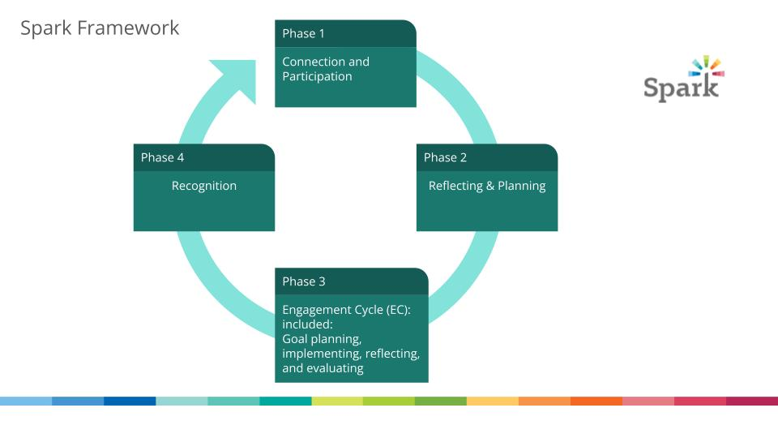
Recommendations
Notes:
The Spark framework will be a 4-phase process with Phase 1- Connection & Participation, Phase 2 - Reflection and Planning, Phase 3 - an Engagement Cycle with self-selecting goals (including goal planning, implementing, reflecting, and evaluating), and Phase 4 - Recognition.

Slide 17
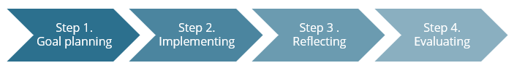
Recommendations
Engagement Cycle
An Engagement Cycle (EC) consists of 4 steps. They are Step 1- Goal Planning, Step 2 - Implementing, Step 3 Reflecting, and Step 4 - Evaluating

Slide 18
Rationale
Spark will empower early educators to make choices about their Spark journey, offering options for goal setting and achievement, accessing resources and measuring progress. Spark will validate that early educators and families will define “quality” differently.
Framework with Engagement Cycles will create a system that is:
  Streamlined and simplified
  Allow programs to work on their own goals that are specific and relevant to them
  Allows opportunities for feedback and support
  Offers programs the opportunity for a formal assessment or a more informal reflection of their program
The Engagement cycle would provide an opportunity to highlight strengths. Offers choice to programs of which distinct content area they wish to work on. It will convey empowerment, flexibility, and respect for what each program wants to do.

Slide 19
4. Measurement of Growth
Notes:
(Ivette) slide 19-22
I would like to now introduce the next concept: Measurement of Growth

Slide 20
Quotes
“Make programs accountable for what they have achieved/ been recognized for.”
“Let the programs feel proud for what they are doing, let’s praise them for their achievement and honor their values.”
“We want Spark to be a system that recognizes engagement and progress.”
“All programs are different; they do not need to be measured on the same criteria.”
“Several of us are not interested in continuing with the stars as it is complicated... We would like to have a mentor who not only tells you what you lack, but who teaches you examples, explains, so that we do not have to copy others … The current process keeps us ‘frozen’ with Spark 's star tracking."

Slide 21
Recommendations
“Measurement of improvement” will be redefined as a Measurement of Growth. Program progress will be measured by the program itself at the end of the engagement cycle. Programs will provide a reflective narrative of their growth while guidance will be provided to create consistency on what programs share and with the flexibility to fill in the specific information that is relevant for them.

Slide 22
Rationale
Spark will empower early educators to make choices about their Spark journey, offering options for goal setting and achievement, accessing resources, and measuring progress·
Spark will validate that early educators and families will define “quality” differently.
Recognize the value of professional development and program growth that programs are already engaged in by themselves or with their CCR&R coaches and count it as part of their participation in Spark.
Let programs highlight their individual strengths and uniqueness and not categorize them by offering unvarying criteria, making them fill the boxes, and forcing them to submit universal evidence and meet mandatory requirements.

Slide 23
5. Documentation & Evidence
Notes:
Marina slide 23-30
Our next concept is : Documentation and Evidence.

Slide 24
Quotes
“The type of documentation that we would ask providers to do for Spark should be accessible to parents to see (showcase to them) so that they can understand what programs are doing.”
“Providers are developing their program for children and families, and not just trying to meet the marks of Spark portfolio. Previously Spark was an all or nothing setup. If programs are forced to do certain things then that isn’t very supportive. Reduce the huge burden of (portfolio) submission. Let programs tell their own story “.
“Offering various options of evidence submission to determine program work will make a system equitable and inclusive.”
“Family feedback is a tool that providers could use to measure their outcomes and reflect on this.”

Slide 25
Recommendations
Spark will utilize a variety of ways for programs to document progress toward meeting their goals. Some examples include:
  Program visit such as observation or assessment
  Photographs, copies of policies, written descriptions, program marketing materials
  Sharing information via video or Zoom meeting (recording may be required)
  Head Start or OPK’s strategic plan
  Families/community testimonials

Slide 26
Rationale
Spark demonstrates its commitment to equity in documentation by accepting various types of documentation. This approach underscores Spark's appreciation for different documentation styles and formats.
Spark offers users flexibility in choosing their preferred method of document submission, empowering them to select the approach that best fits their needs and workflow.

Slide 27
6. Recognition
Notes:
Marina slide 27-30
Our next concept is : Recognition

Slide 28
Quotes
“If this is about improving the Spark program, I would love the 3, 4 ,5-star rating to be changed. When my families were told that I had received a 3-star rating, their first question was always 3 out of how many.”
“My parents chose my program for what makes my program unique more than stars.”
“Star-rating system takes the focus off of the process and puts it on just getting to the next level. It also creates some assumption that one program is better than another. But it is not true.”
“As providers, we are eager to race to reach a star. However, for providers, reflective practices have to be more important than meeting some general criteria and achieving a certain star level.”

Slide 29
Recommendations
Recognition will be given for the completion of an Engagement Cycle where programs have worked to accomplish specific goals relevant to their individual values and needs (instead of the overall generalization of having a star rating). Programs will be recognized with the receipt of a Certificate of Achievement with specific information regarding the program’s activities. Programs will also receive a financial Recognition Incentive.

Slide 30
Rationale
Spark will empower early educators to make choices about their Spark journey, offering
options for goal setting and achievement, accessing resources, and measuring progress.
Spark will validate that early educators and families will define “quality” differently.
Spark will support and empower families to find care that aligns with the needs, values, and culture of their family.
Replacing the star rating system with Certificates of Achievement for the completion of each goal cycle will recognize the individual strengths of every program and highlight programs’ achievements rather than meeting predetermined criteria and/or even failing in the pursuit of rating.
This system can help parents see the unique values and strengths of a program and will emphasize what is important for families. Parents will be able to choose programs based on what is important to them.

Slide 31
7. Information for Families & Families Voice
Notes:
Lauren slide 31- close
Our next concept is : Information for Families and Families Voice.

Slide 32
Quotes
“The value and reputation of our program comes from our relationships with the families we serve.
“Whatever is built for families should be done with the family input vs. a creating a system on general ideas with hope that it will “fit” family needs”
“Spark should be a listener of the community and providers and parents and then share back out to the larger system what is happening on the ground.”
“What Spark wants to do is highlight elements of each program to showcase their work to help parents find a program that fits their needs.”
“Parents need to be able to distinguish the different programs and what they offer. The badge system can help them to make conscious choices.”

Slide 33
Recommendations
Spark will create 2-way communication with families and communities to help them understand Spark’s purpose and how the programs they are working with are involved. Accessible materials will be created in both print and digital formats in 5 languages, including places where families access services for their children. Spark will develop resources or tools for programs to effectively communicate their participation story with families. Spark will strive for maximum visibility on Find Child Care Oregon, making it easy for families to identify programs participating in Spark to the fullest extent possible.

Slide 34
Rationale
Spark will support and empower families to find care that aligns with the needs, values, and culture of their family.
Spark will validate that early educators and families will define “quality” differently.
Spark will ensure that participating programs have met basic health and safety standards and will communicate this to families.

Slide 35
Clarifying Questions
Notes:
Lauren

Slide 36
Next Steps

Slide 37

Thank
you

