Slide 1

Introduction to Spark
CKC: Program Management, Set 1

Slide 2
Welcome!
Introductions
Training is being recorded*
Please type your name in the chat
Notes:
Training is being recorded
POLL 1
POLL 2
Ask participants to type their names in the chat for attendance purposes.
Invite participants to ask questions by raising their hands or using the chat box.
Inform participants that they will be completing an evaluation of the training at the end of the session.
Ask participants to mute their microphones. Encourage participants to leave on their cameras.
Let participants know that they will receive ORO credit for the session but they must stay through to the end. We will submit the hours to ORO core knowledge category of Program Management.

Slide 3
Training Objectives
Available resources
&
Financial supports
Spark redesign & participation pathways
Gain the knowledge needed to start
and succeed
in Spark
Purpose of Spark
&
Benefits of participation
Steps to follow
Notes:
Training outcome and objectives
Review the overall objectives for the Spark orientation

Slide 4
The Purpose of Spark &
The Benefits of Participation

Slide 5
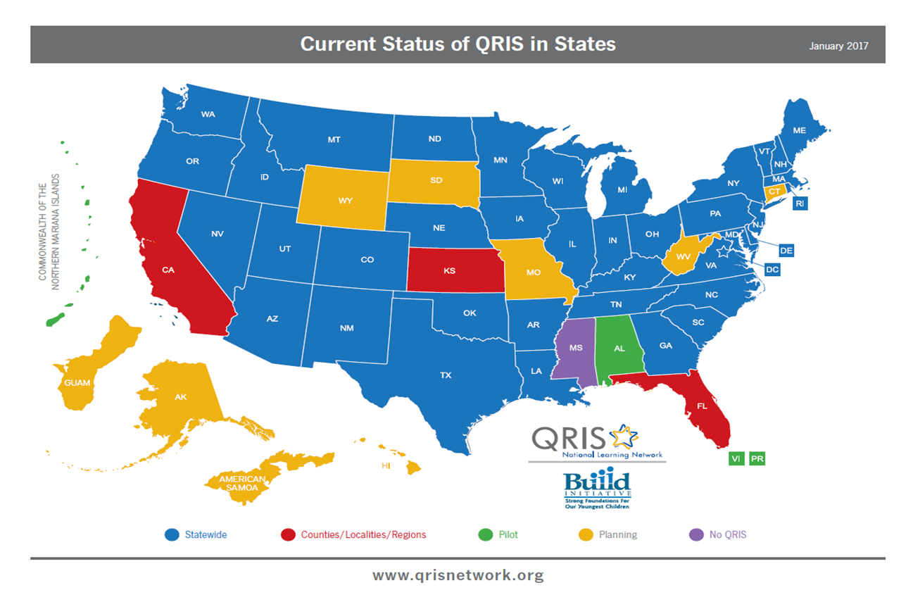
Quality Recognition and Improvement System
QRIS
Notes:
Spark is a Quality Rating and Improvement System or QRIS
The use of Quality Rating and Improvement Systems began in the late 1990’s.
Every state has a version of a QRIS (including Missouri, since the development of this map) and they all have their own criteria and systems. There is not a national model of a QRIS.
Oregon’s QRIS is called Spark
Oregon developed its QRIS in 2013

Slide 6

Coordinated System with Key Early Learning Partners
DELC (Department of Early Learning and Care)
TRI (The Research Institute)
OCCD (Oregon Center for Career Development)
CCR&Rs (Child Care Resource & Referral)
Notes:
Trainer Notes:
Oregon’s QRIS is part of the larger early learning system.
ELD - provides the funding and leadership for Spark. ELD is responsible for all final decisions related to Spark.
TRI - is responsible for the administration of Spark, including supports and incentives, portfolio review, compliance review and rating maintenance
OCCD - partners with Spark by providing information and TA regarding professional development planning and tracking.
CCRRs - engage and support programs’ participation in Spark within their local communities.

Slide 7







Coordinated System with Key Early Learning Partners
Oregon Center for Career Development (OCCD)
Child Care Resources & Referral (CCR&Rs)
Notes:
Trainer Notes:
Oregon’s QRIS is part of the larger early learning system.
ELD - provides the funding and leadership for Spark. ELD is responsible for all final decisions related to Spark.
TRI - is responsible for the administration of Spark, including supports and incentives, portfolio review, compliance review and rating maintenance
OCCD - partners with Spark by providing information and TA regarding professional development planning and tracking.
CCRRs - engage and support programs’ participation in Spark within their local communities.

Slide 8

211 Info: Parent referrals
Head Start, Preschool Promise, OPK
Culturally specific CBOs
ERDC
Infant & Toddler Initiative
Hubs
Early educators
Families
Inclusive Partners
Notes:
In addition to the ones we highlighted, there are many other people and agencies that interact with Spark, either as participants or as programs and agencies that work with early educators and/or children and families

Slide 9
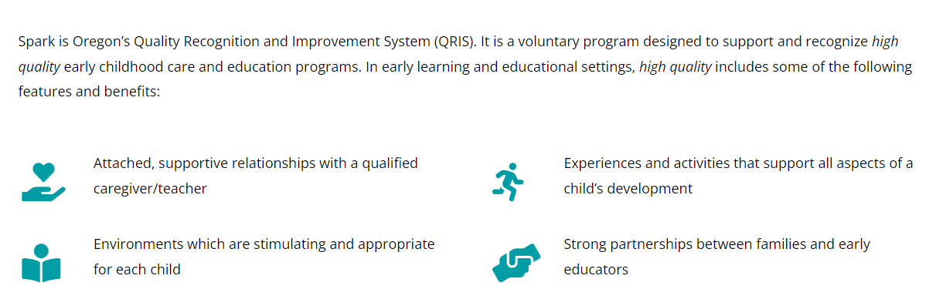
Purpose of Spark
Notes:
These are the components of “high quality” which Spark deems essential
Spark exists to support programs continually increasing their quality in these areas

Slide 10
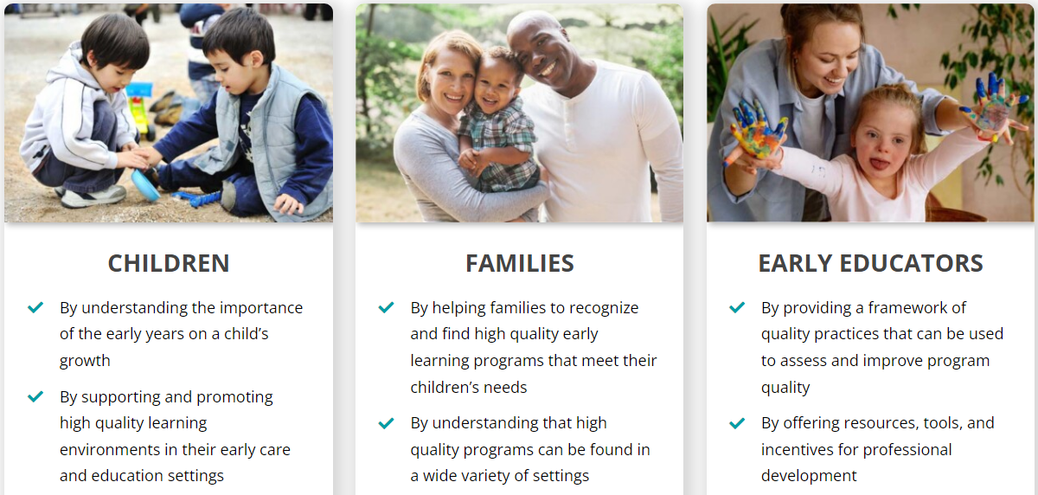
Who does Spark Support?
Notes:
Who is Spark for?
Children
Families
Early Educators
Read through each section of the slide focusing on the ways in which Spark benefits children, families and early educators

Slide 11
Who can participate in Spark?
To be eligible to participate in Spark, programs must:
Meet Department of Early Learning and Care compliance requirements
Be licensed
OR
Be operated by a school district or other governmental agencies that is exempt from licensing
Notes:
Discuss Spark eligibility with participants.
Compliance will be discussed in more detail on slide 20

Slide 12
Benefits of Participation
Professional recognition
Program improvement
Financial supports & incentives
Marketing to families and your community
. . . a way to help demonstrate you care about having the best program possible!
Notes:
Discuss the benefits of being part of Spark
If you wish, you can engage the participants by asking what they hope to get out of participating in Spark

Slide 13

Questions ?
Notes:
Ask participants to share any questions they have, either by raising their hands or in the chat.
There are often questions related to financial supports. You may ask participants to hold onto those questions until that section of the orientation is completed.

Slide 14
Resources &
Financial Supports
Notes:
Spark has many resources available to support your participation.
You do not need to do this alone!

Slide 15
Available Resources
Spark website
      oregonspark.org
Quality Improvement Specialists (QIS) from your local Child Care Resource and Referral agencies (CCR&R)
      oregonspark.org/ccrr-regional-map/
Spark Helpline at The Research Institute, WOU
      ​1-877-768-8290 / oregonspark@wou.edu
Oregon’s QRIS Resources Website
      oregonqrisresources.org
Notes:
Spark Supports
We encourage programs to take advantage of free Spark resources!
There are a number of supports available to programs (briefly review the list on the slide).
The Spark website has copies of Spark documents, data facts, Spark newsletters and information that can be shared with families WE WILL GO TO THE WEBSITE AT THE END
The Oregon QRIS Resources website is available to programs after they achieve the Commitment to Quality designation. This website offers sample forms and other information to assist with program improvement.
Quality Improvement Specialists are from CCR&Rs that are available to assist programs with program improvements. THEY WILL INTRODUCE THEMSELVES AT THE END
Portfolio support is available from TRI/WOU to address general questions that programs may have as they put their portfolios together.
Financial supports that we will talk about next.

Slide 16
Financial Supports
Support Funds:
Incentive Funds:
C2Q programs may apply for Support Funds
Amount determined by program size ($1,000 - $2,000)
Must be used to support quality improvements (Some restrictions apply. Remember to save your receipts!)
Awarded by TRI after program receives a star rating or completes a Quality Improvement Cycle to recognize achievements
Amount depends on program size and rating awarded
Must be used to support quality improvements (Some restrictions apply. Remember to save your receipts!)
Notes:
Spark financial supports can be used for costs related to making program improvements and maintaining quality practices
The Quality Improvement plan can assist in determining how to spend your Spark funds
Funds can not be used for capitol improvements (permanent changes to your home/facility) or religious materials and are not intended for general program operating costs
Programs must complete a Request for Supports form and a WOU Substitute W-9 form is required. Funds may be taxable. Speak with a financial advisor to understand any tax implications.
The amount of funds are determined by program size and when applicable, star level achieved.
Support funds range from $1000 to $2000 depending on program size
Incentive funds range from $500- $2500 depending on program size and star level achieved
Accredited such as NAEYC and NAFCC programs receive different amounts
Head Start programs are not eligible for Spark funds

Slide 17
Questions ?
Notes:
Allow time for questions.
More questions than time, we will try to answer them all at the end, use the chat we can also email answers or email the Spark helpline
We will take a couple of questions and then move on…

Slide 18
Spark Redesign & Participation Pathways

Slide 19
Spark Redesign
Spark is in the process of being redesigned by a community engagement model.
  Input is being gathered from providers, parents, and others in the ECE field representing a diverse range of program types, roles, race, ethnicity, language, and geographic area.
The focus will be on Continuous Quality Improvement and a system that is:
  inclusive
  equitable
  supports early learning programs and families to offer the best possible early learning experiences to children.

Slide 20
What is Staying the Same?
All Spark processes and forms continue to be available in English, Spanish and Russian.
All new participants can apply to Spark, receive a C2Q designation, and receive support funds.
Currently rated programs may still renew their rating.
Programs that are currently Spark rated and listed with ERDC will continue to receive the ERDC monthly incentive payment for Spark rated programs.
No ratings will be taken away due to ERDC listing status.

Slide 21
What has changed?
Must be listed with ERDC to submit a portfolio and receive a star-rating. (or apply for a higher rating)
A 12-month Quality Improvement (QI) Cycle has been developed so all programs can participate in Spark.
All forms and information have been moved to online formats. Only the actual portfolio will remain a paper copy.

Slide 22

The Spark Pathways
Spark Pathways
Portfolio Pathway
QI Cycle Pathway
Must be ERDC listed
Notes:
This is an overview of the 2 different pathways to participate in Spark
The Portfolio Pathway (must be ERDC listed to do this)
The QI Cycle Pathway (everyone can do this)
Start by completing the Spark Participation Application (on-line form).
TRI staff will review your application and you will be sent an email specific to the path you choose.

Slide 23
Portfolio Pathway
Complete Spark Participation Application (e-form)
Choose the Portfolio option (if ERDC listed) and submit the application
Receive an email with information, C2Q certificate, other documents, and links to forms and resources
Apply for Support Funds (one time only)
Receive portfolio, work on completing it
Submit portfolio for rating
Receive rating or feedback on issues preventing rating. Resubmit if needed.
When rating achieved, receive incentive funds ($500-$2,500)
Apply for a higher rating, complete rating renewal when rating expired, eventually transition to redesigned Spark.
Notes:
If you choose the Portfolio Pathway:
TRI staff will review your application and check that your program meets compliance requirements to be Commitment to Quality (C2Q), if the program is not license-exempt.
You will be sent an email that will include your printable C2Q certificate, welcome documents, and links to resources and support documents and a link apply for support funds.
Your portfolio will be sent in the mail.
Use the resources that are available!

Slide 24
Spark Participation - Portfolio Pathway (ERDC listing required)
Orientation
Application
Self Assessment (optional)
Quality Improvement Plan (optional)
Apply for Support Funds
Portfolio Completion & Submission
Receive Incentive Funds
Apply for higher rating, renew, transition to new Spark

Slide 25
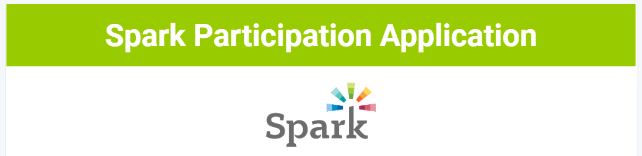
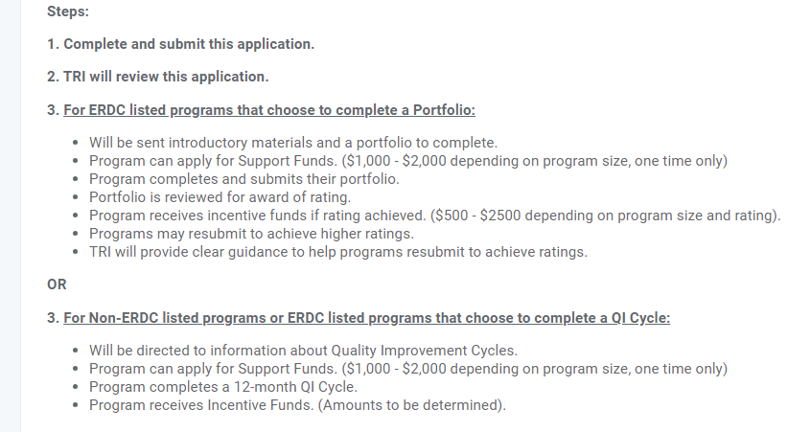
Step #3 is either the Portfolio or the QI Cycle Path.
Portfolio Pathway
Notes:
The application lists the steps for participation.

Slide 26
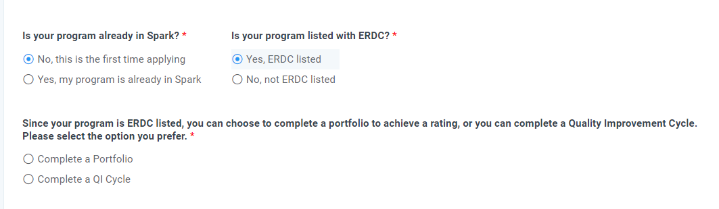
Choose the Portfolio option
Notes:
The application asks if you are ERDC listed. If you choose yes, you have the option of choosing Portfolio or QI Cycle.

Slide 27
Welcome Email – Portfolio Pathway
Your welcome email will include:
Printable C2Q Certificate
Links and documents with information on:
How to apply for support funds
Spark Rating Overview
Compliance requirements (to achieve and maintain a rating)
Explaining Spark to Families flier (suitable for display)
How to sign up for a free user account on OregonQRISResources.org
Notes:
The Spark welcome email will contain downloads and/or links to:
Commitment to Quality Certificate
Compliance poster which explains the requirements to achieve and maintain a rating
How to apply for support funds using the TRI Payments Portal
Spark flyer to explain Spark to families to display in your program
Information on how to sign up for the QRIS Resources website
If you need anything printed and mailed to you, contact the Spark Helpline.

Slide 28
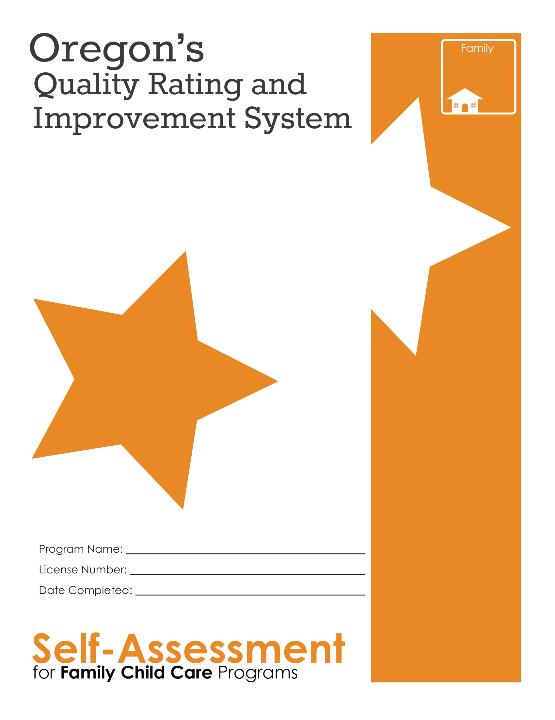
The Spark Self-Assessment is an opportunity to become familiar with the Spark standards.
See what program practices are currently in place that align with the Spark Standards.
Available on the Spark website in the resources: https://oregonspark.org/interested-participants/
Notes:
If time allows, go to the Spark website and show where the document is located.
Encourage participants to take time to go through this to prepare for the portfolio. Participants on either pathway may find this useful.
It does not need to be sent to us.

Slide 29
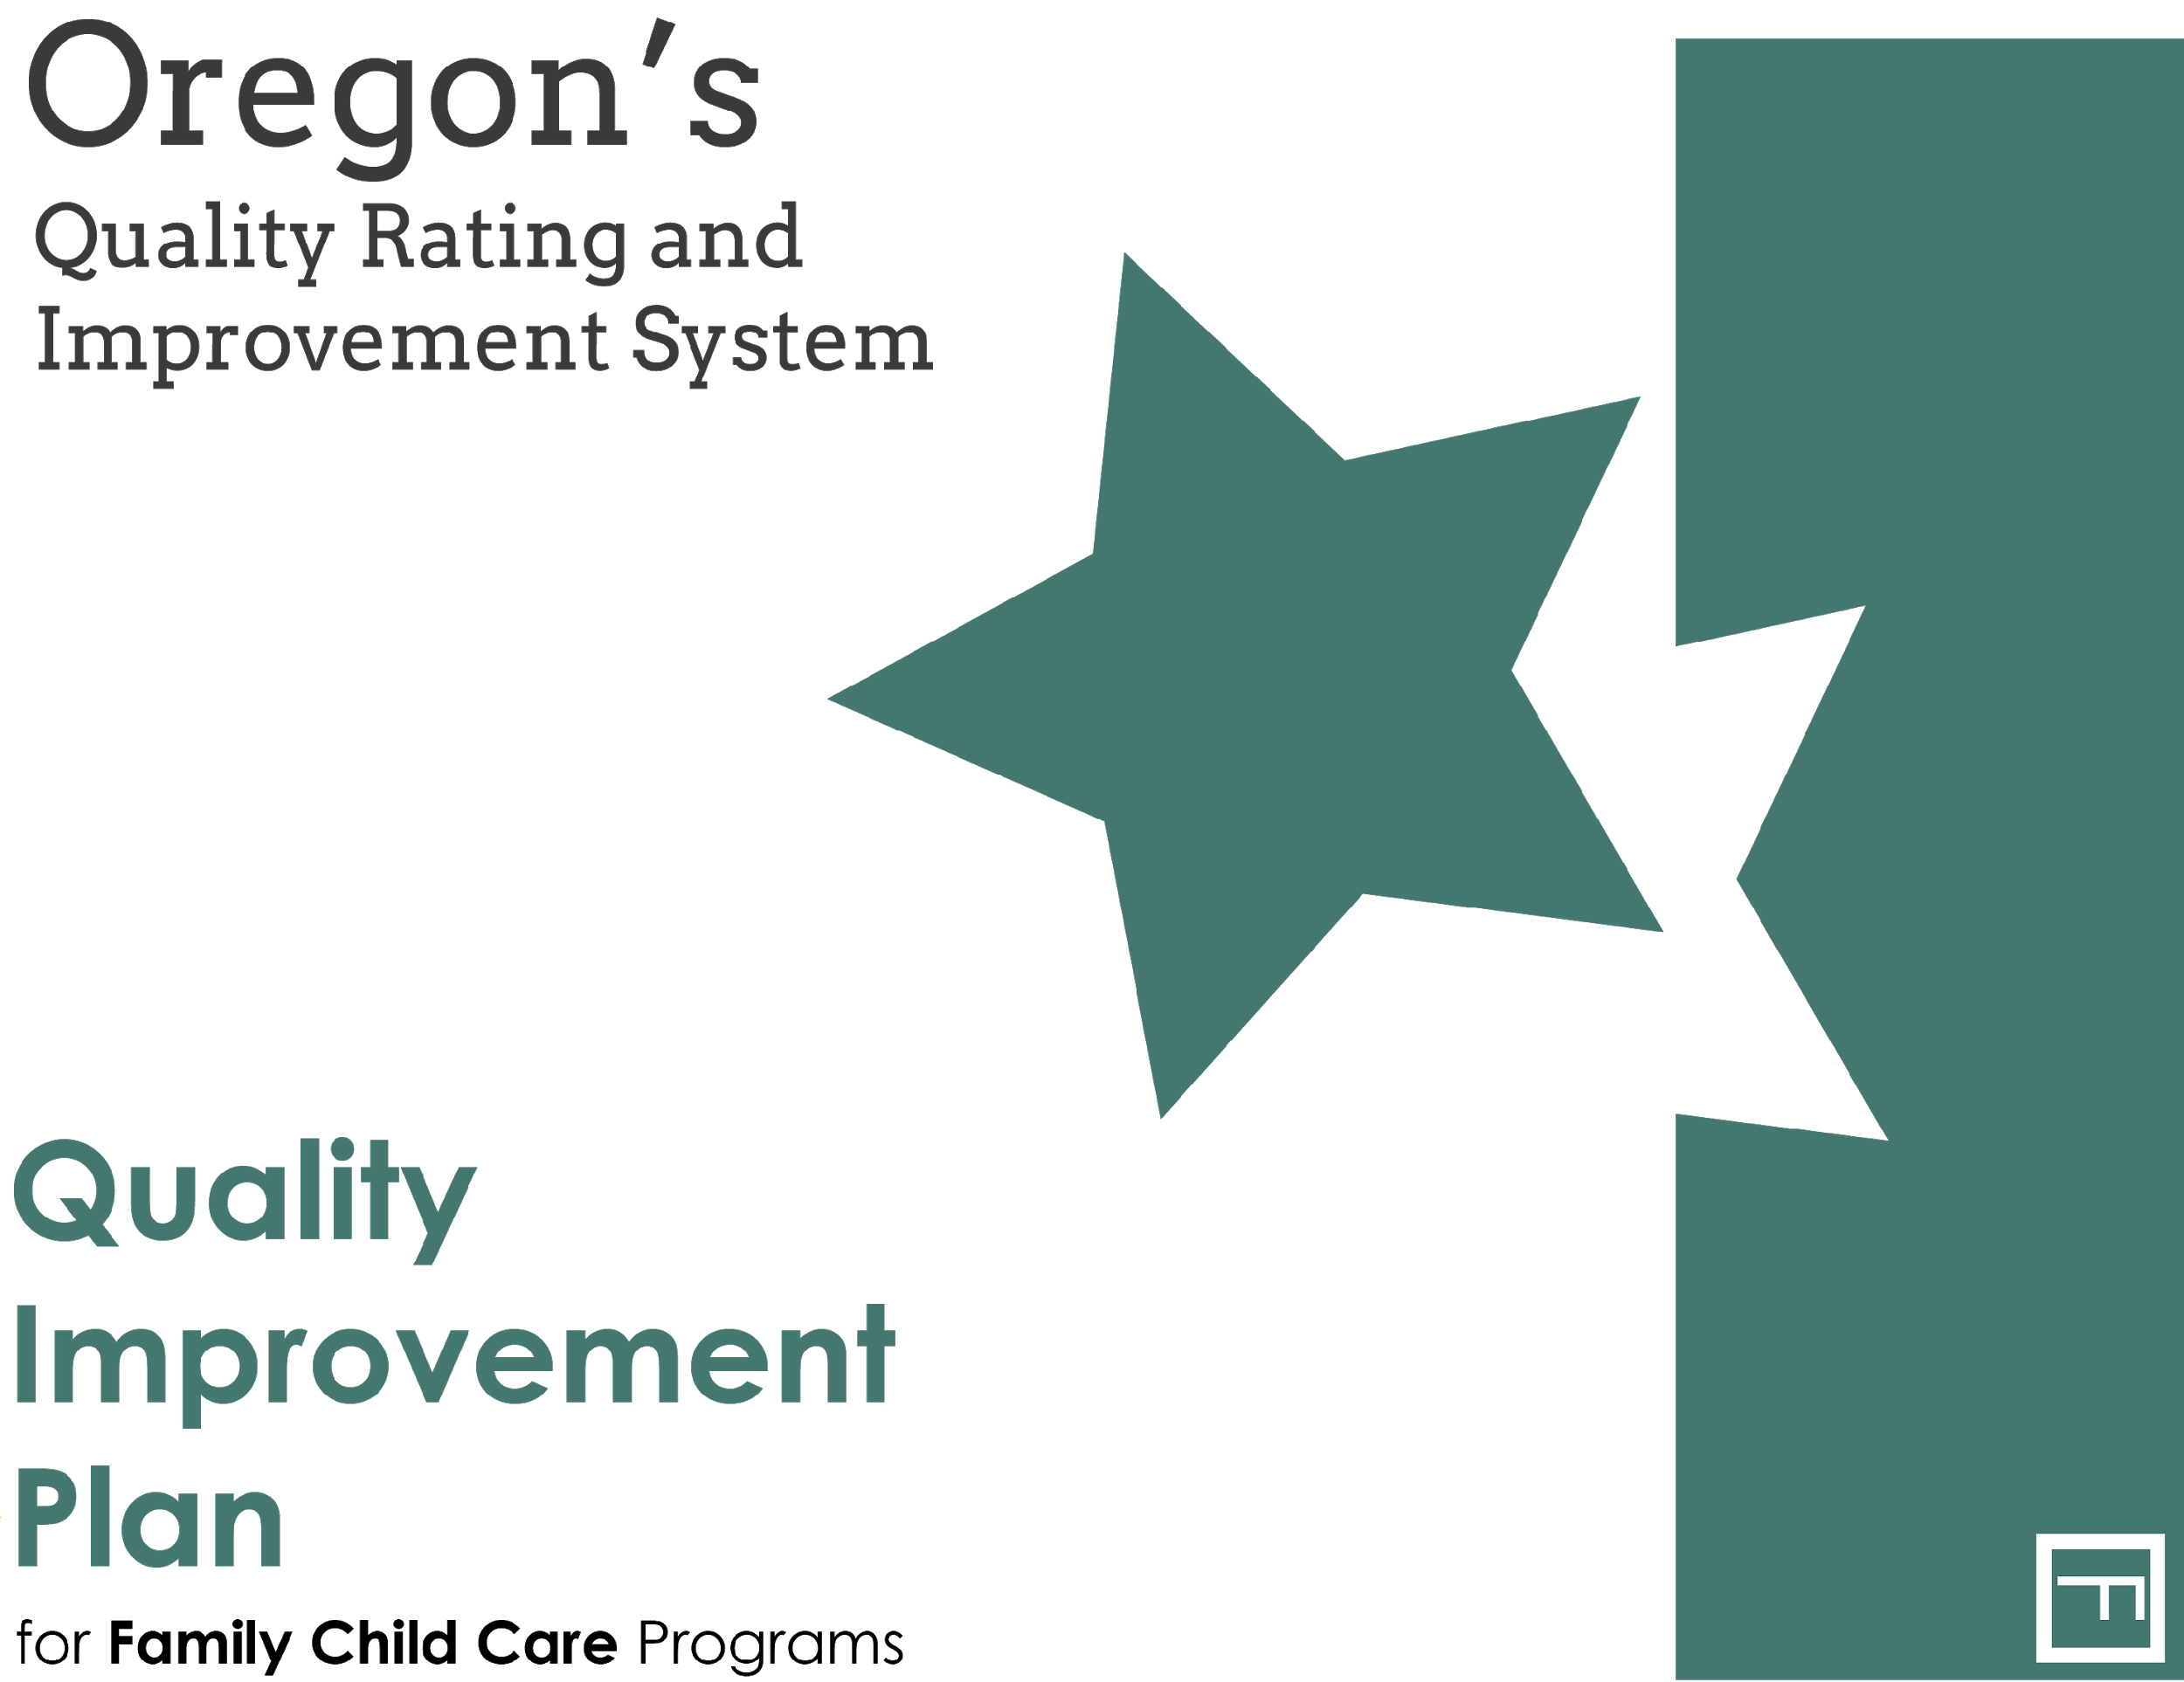
The Quality Improvement Plan is your road map for your Spark journey!
It’s a helpful document when planning how to approach completing the portfolio.
Available on the Spark website in the resources: https://oregonspark.org/interested-participants/
Notes:
Participants will have access to a copy of the QIP on the website.
The QIP will help you identify areas where you are currently meeting Spark standards and areas where you would like to make program improvements
The QIP is a roadmap for this part of the Spark process. It will help you set goals and plan the steps to achieve them. It is important not to rush!
Programs may decide at this point which star level they are seeking, or they may decide that later. The QIP will allow them to see what specifically is required at each star level.
They may choose to only complete the star levels they are seeking or they may complete the QIP at all star levels.

Slide 30
Apply for Support Funds Portfolio Pathway
Amounts range from $1,000 - $2.000 depending on program size. (Capacity under 20 = $1,000, 21-49 = $1,500, over 50 = $2,000).
The TRI Payment Forms is the Secure Portal on the WOU Website that is used to download and submit all financial forms.
You will receive the link to the portal with detailed instructions in your Spark welcome email.
Notes:
Instructions will be in your email –
Portfolio path, it will be in the Welcome email
QI Cycle path, it will be in the email received after you complete the QI Cycle participation form

Slide 31

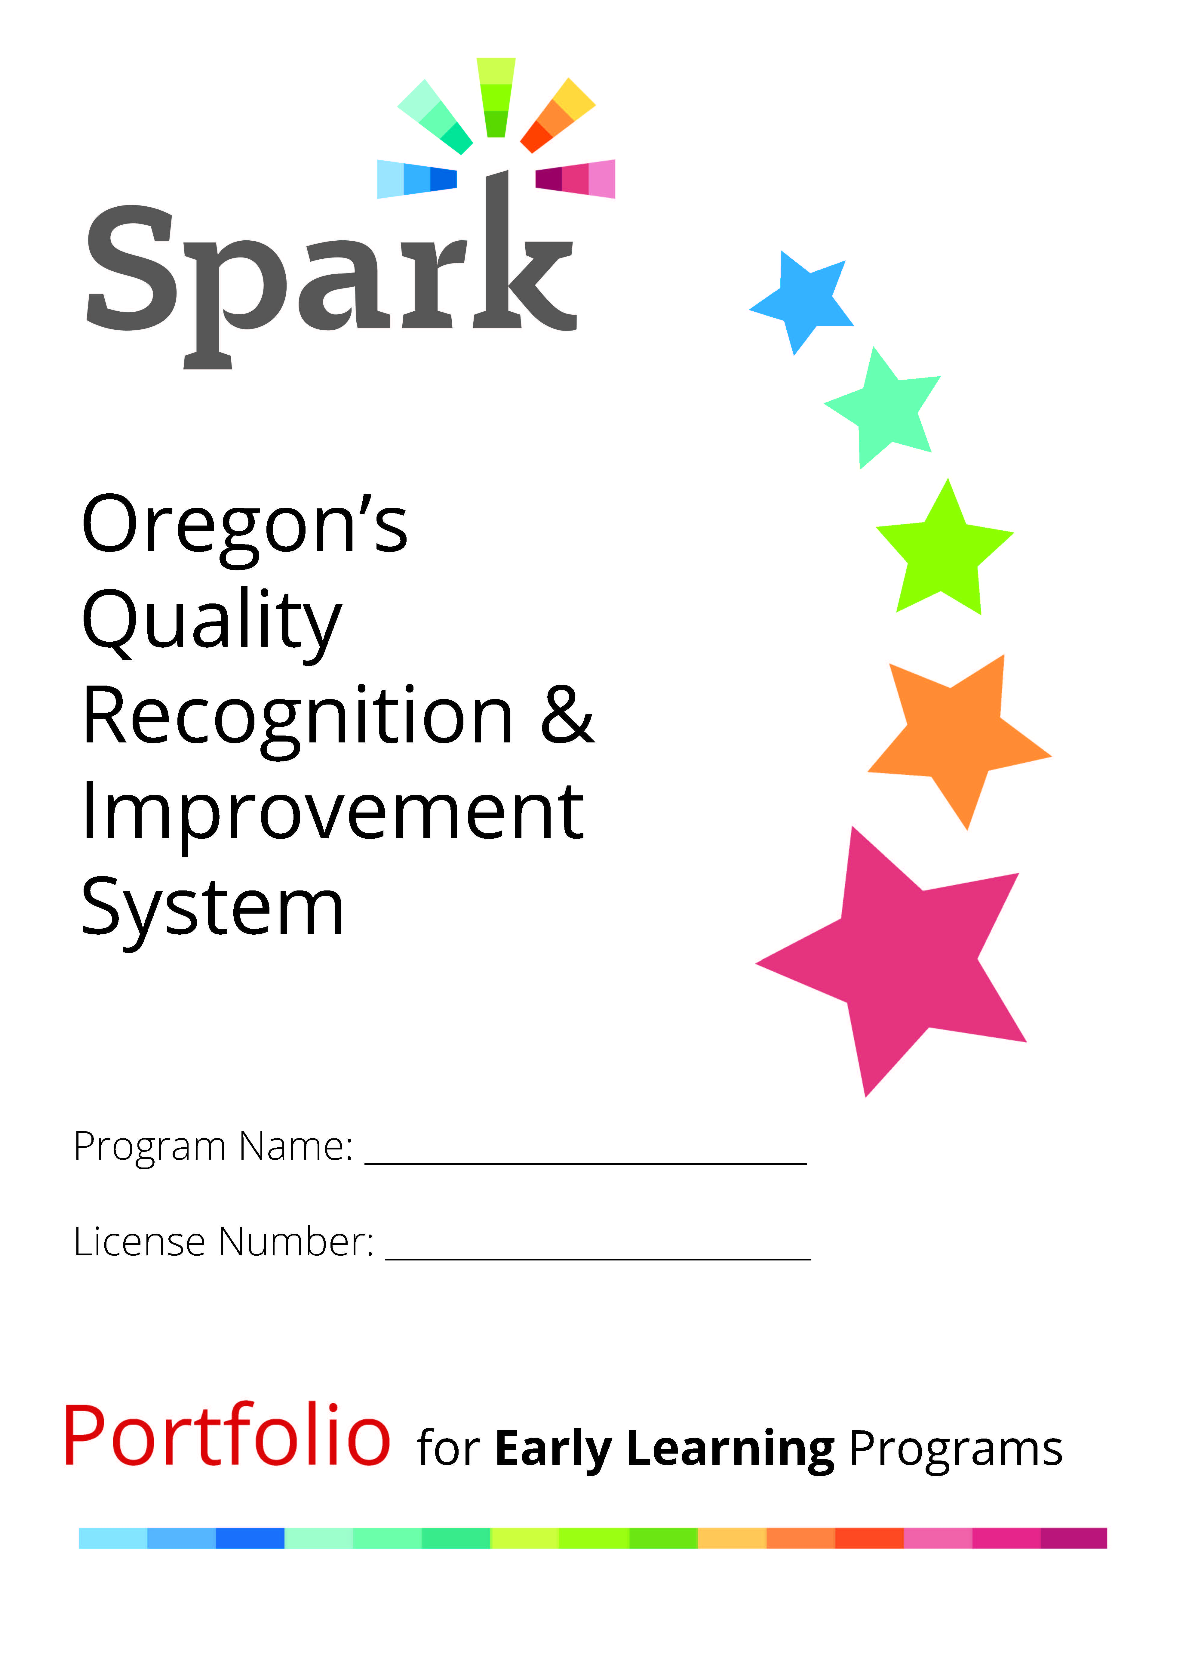
The Spark Portfolio
Tell your authentic story
Demonstrate quality of your program
Document your program practices
Submit your portfolio to achieve a rating
Notes:
The portfolio is a unique aspect of Spark. Most other states do not use the portfolio system.
Completing and submitting a portfolio is required to achieve a star rating.
Completing your portfolio is your chance to share your program’s unique practices, policies and environment as they relate to the Spark standards
You will receive detailed reviewer feedback when your portfolio is returned to you. If you don’t achieve the rating your want the first time, you are encouraged to apply again – reach out for assistance if needed.
Star rating is good for 3 years. You can resubmit for a higher rating at any time.

Slide 32
Rating Renewal
Program can renew their rating when it is close to expiring. (ratings are currently good for 3 years)
Program completes a Spark Program Update Report (SPUR) to start the process.
Program will be emailed information about the renewal options and a 3-month extended certificate.
When the renewal activity is completed, they will receive a certificate and $200 Renewal Incentive payment.
Notes:
When your certificate is close to expiring, complete a SPUR to request a rating renewal
There are currently 5 options to renew your rating
All of the options are listed on the website and you can choose any of the 5
If there are any changes to the options related to transitioning to redesigned Spark, it will be communicated and explained on the website

Slide 33
Rating Renewal Options
Resubmit for a higher rating
Renewal portfolio *Mini portfolio
On-Site Observation
Quality Improvement Activities
  Collaborative Quality Improvement Activity
  Begin a QI Cycle
Professional Development Activities
*$200 Renewal Incentives will be awarded after completion.
*For more details, visit oregonspark.org (Current Participants – Rating Renewal)

Slide 34
Questions ?
Notes:
Allow time for questions.
More questions than time, we will try to answer them all at the end, use the chat we can also email answers or email the Spark helpline
We will take a couple of questions and then move on…

Slide 35
QI Cycle Pathway
Complete Spark Participation Application (e-form)
Choose the QI Cycle option and submit the application
Receive an email with information, C2Q certificate, other documents, and links to forms and resources
Complete the QI Cycle Participation Form and list your goal. Apply for Support Funds (one time only)
Work on achieving the goal you choose on the Participation Form
Utilize resources provided or find your own. Reach out for support if needed
Complete QI Reflection Form after 12-Months
When Reflection completed, receive incentive funds (amount to be determined)
Choose another goal for QI cycle, transition to redesigned Spark if it's ready.
Notes:
If you choose the QI Cycle Pathway:
TRI staff will review your application and check that your program meets compliance requirements to be Commitment to Quality (C2Q), if the program is not license-exempt.
You will be sent an email that will include your printable C2Q certificate, welcome documents, and a link to complete the QI Cycle Participation Form which includes links to resources and support documents
.
Use the resources that are available and reach out if you need assistance

Slide 36
Step #3 is either the Portfolio or the QI Cycle Path.
QI Cycle Pathway
Notes:
The application lists the steps for participation.

Slide 37
Choose the QI Cycle Option
Notes:
The application asks if you are ERDC listed. If you choose yes, you have the option of choosing Portfolio or QI Cycle.

Slide 38
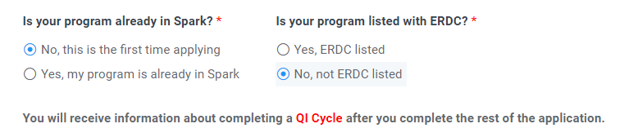
Only the QI Cycle is displayed if “Not ERDC listed” is selected
Notes:
The application asks if you are ERDC listed. If you choose yes, you have the option of choosing Portfolio or QI Cycle.

Slide 39
Spark Participation Path for Non-ERDC listed
Orientation
Application
Begin a QI Cycle by completing a QI Cycle Participation Form
Request Support Funds
Complete QI Cycle
Complete Reflection (after 12 months)
Receive Incentive Funds

Slide 40
Welcome Email – QI Cycle Pathway
Your welcome email will include:
Printable C2Q Certificate
Links and documents with information on:
How to complete the QI Cycle Participation Form
Compliance requirements (to achieve and maintain a rating)
How to sign up for a free user account on OregonQRISResources.org
After completing the QI Cycle Participation Form, you will receive the link to apply for support funds.
Notes:
The Spark welcome email will contain downloads and/or links to:
Commitment to Quality Certificate
Compliance poster which explains the requirements to achieve and maintain a rating
Secure Portal - Information on how to apply for support funds
Information on how to sign up for the QRIS Resources website
If you need anything printed and mailed to you, contact the Spark Helpline.

Slide 41
Quality Improvement Cycles
Steps of the QI Cycle
Choose a goal
Record the goal on the QI Cycle Participation Form
Explore resources, work on goal, reach out for help if needed
Complete QI Cycle Reflection Form after 12 months
Receive Incentive Funds (Amount to be determined)

Slide 42
QI Cycle Participation Form
Follow link in welcome email to access the form
Explains steps in detail
Has section on goal planning & resources
  Tips on how to choose goals
  Examples of goals have been provided in each Spark domain and potential resources (clickable links and also downloadable)
Has section to document your goal – using SMARTIE goal framework (Specific, Measurable, Achievable, Realistic, Time-bound & Tracked, Inclusive, Equitable)
Email confirmation will be sent to submitter and QIS in your area.
Notes:
Must be completed to record your participation in the QI cycle.
You can put your start date of beginning to work on your goal, then the 12-month period begins.
You can start the form and return to it later to complete it.
Reach out to your QIS for help
You can always change your goal for any reason later

Slide 43
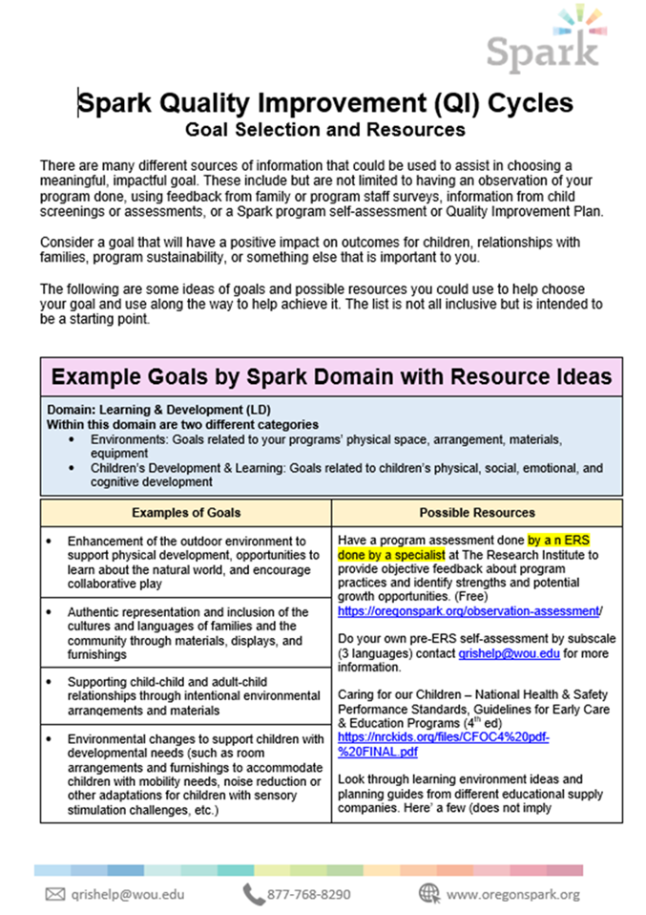
QI Cycle:
Goal Selection and Resources Document
Examples of goals
Resources to help you complete your goal
Notes:
This form is available to view and/or download as a pdf from the QI Cycle Participation Form
It can help you:
Choose a goal
Find resources to help you achieve your goal
This is a live document and we will be updating it periodically
If you find other helpful resources, please share by emailing the Spark Helpline

Slide 44
Apply for Support Funds –
QI Cycle Pathway
Amounts range from $1,000 - $2.000 depending on program size. (Capacity under 20 = $1,000, 21-49 = $1,500, over 50 = $2,000).
The TRI Payment Forms is the Secure Portal on the WOU Website that is used to download and submit all financial forms.
You will receive the link to the portal with detailed instructions after completing the QI Cycle Participation Form.
Notes:
Instructions will be in your email –
Portfolio path, it will be in the Welcome email
QI Cycle path, it will be in the email received after you complete the QI Cycle participation form

Slide 45
QI Cycle: Reflection Form
The Reflection form is to be completed after 12 months
You will receive an email reminder with the link before the end of the 12 months
Email the Spark helpline if you didn’t receive it
Record your progress on goal achievement and answer reflection questions
You will receive incentive funds after it is completed
Notes:
You will receive a link in your QI Cycle Participation Form confirmation email so you can preview it. But don’t fill it out until the 12 months is over.
You will be sent the link again and a reminder close to the end of the 12-month period.
This is to record your progress on your goal achievement – what went well, what didn’t, program impact, lessons learned, etc.
After completing it, you will automatically receive your incentive funds – you do not need to apply for them.

Slide 46
Questions ?

Slide 47
Spark Program Update Report (SPUR)

Slide 48
Why Fill Out a SPUR?
Update program information
Rating renewal / Updated certificate
Rating reinstatement after revocation
Request replacement of portfolio
Request a rating transfer due to a license change
Participating in a rating maintenance
*SPUR links can be found at oregonspark.org on Current Participants page
Notes:
Programs are encouraged to complete a SPUR annually to update program information and share information about continued participation in Spark.
Also:
Rating renewal / Updated certificate
To request that a rating be reinstated after revocation (currently this only happens when serious licensing violations occur)
Request replacement of portfolio
Request a rating transfer due to a license change
Participating in a rating maintenance – requested by Spark staff as part of the process

Slide 49
Ready to get started?

Slide 50



Available Resources
Quality Improvement & additional materials:
  Quality Improvement Specialist (QIS) at local CCR&R
  Oregon QRIS Resources Website: www.OregonQRISResources.org
Portfolio, Financial & General Spark Information:
  Quality Improvement Specialist (QIS) at local CCR&R or Hub
  The Research Institute:
    Spark Helpline: 1-877-768-8290
    Email: oregonspark@wou.edu
    Website: oregonspark.org
Notes:
There are many resources available!
As you work through the Spark process or if you have questions about Spark, remember that you have a number of resources available to help you.
For questions or help and for resources related to program improvement you can contact your Quality Improvement Specialist, the CCR&R ORO specialist, or your PSP coach or access the Oregon’s Spark Resources website.
For general questions you may contact TRI toll free helpline number is 877-768-8290 or e-mail oregonspark@wou.edu
The Spark website also has general information.
If applicable, apply for the support funds. (Information about how to do this is in the Welcome Kit)
Sign up for the QRIS Resources website

Slide 51

Questions and Comments

Slide 52
Final Thoughts
Thank you for joining us!
  ORO credit will be given
  Please complete an evaluation
  Type your name in the chat box
Notes:
Thank the participants for attending and for their interest in Spark.
Let them know that ORO credit will be given and they will not be receiving a training certificate.
Encourage participants to complete the brief evaluation

Slide 53
Thank you!
Notes:
Closing
Announce that this is the closing section and describe the activities:
This section will take about 10 minutes.
Inform participants that they will complete an evaluation to give us feedback on this workshop.
Explain that certificates will be issued at the close of the workshop.
Workshop evaluation
Explain that we evaluate our training so we can be sure it is helpful to our participants.
Encourage participants to let us know what portions of the training were particularly useful for them and to also let us know what could be improved upon and how.
Remind participants they do not have to put their name on the evaluation.
Have participants complete their evaluation forms and turn them in to you.
Certificates
Thank participants for their participation and hand them their certificates. Note that the number of hours of the workshop is on the certificate. Also let them know that they should file it along with their objectives since they can be used to document contact hours for the Oregon Registry to move up on Registry Steps and the Office of Child Care for licensing requirements.
Invite participants to contact you if they have any questions and remind them that there is a lot of support available for the Spark process

