Slide 1

Spark Webinar
November/December 2024

Slide 2
Welcome and Introductions
Spark Team – TRI
Ash Mickels, Haleb Loul – DELC
Notes:
Who has their tree up, if you celebrate
Lights

Slide 3
Agenda
Initial goal setting conversations with programs:
Approaches, considerations, strategies
Notes:
Much of our work with programs is centered around goal setting
Redesigned Spark will be focused on goal setting
There are a lot of strategies for goal setting, templates, etc
Today, I want to just focus on that initial conversation with programs, introducing the idea (and expectation) of goal setting
This is a critical conversation that really sets the stage for how the provider is going to feel about the process

Slide 4
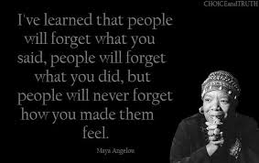
Goal Setting with Early Learning Programs
Share small group thoughts, experiences, and ideas
Notes:
Who here has done goal setting with programs? Optional or required?
Whose idea was the goal?

Slide 5
Goal Setting
What are some other words or phrases for “goal?”
Notes:
The word goal may have different meaning and connotation for different programs.
How might you have this conversation without the word “goal”?

Slide 6
Goal Success? Or not?
A goal you set for yourself that you achieved… what worked?
A goal you set for yourself that you did not achieve…what, if anything got in the way?
Notes:
Cvs… being told what my goals were (off of a cheat sheet!)

Slide 7
Small Groups
In your experience, how have programs responded to goal setting conversations when goal setting is a requirement?
How do you approach these conversations?
What strategies do you use to assist with goal setting?
Notes:
Someone take notes and share

Slide 8
Large Group Discussion
Share small group thoughts, experiences, and ideas

Slide 9
Resources and Supports
What resources can you share?
What resources and supports are needed to work with programs in determining meaningful goals?

Slide 10
Help Desk

