Slide 1
Concept 1: Eligibility
Proposal
All licensed and license-exempt* programs and providers will be eligible to participate in Spark.
*License exempt programs include all types of recorded, regulated subsidy programs, and all license exempt providers that are regularly working with children and would like to participate in Spark.
Key Points to Address:
Build out the budget for expansion
Gradual expansion of eligibility
Onboarding new programs
Inclusion of Tribal Programs
Align with CCDF requirements and statute

Slide 2
Concept 2: Tiers
Proposal
Spark will be structured as a non-rated tiered system with an emphasis on support and recognition. Tiers will be based on the level of participation* and will offer different types of support** for programs.
Key Points to Address:
Health and safety criteria
Health & safety accountability for license-exempt providers and facilities
Culturally responsive support for Tribal programs
Enhanced Tier(s):
Possibly depending on # of Engagement Cycles completed
Participation Tier:
Demonstrate meeting basic health and safety requirements

Slide 3
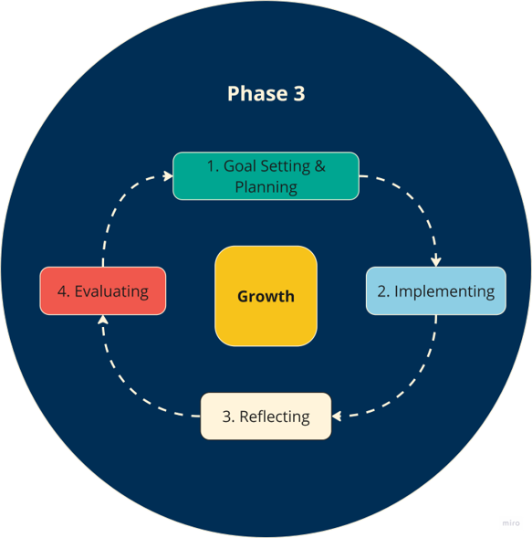
Concept 3: Spark Framework
Proposal
Support Grants
Key Points to Address:
Goal setting focus areas/domains
Menu of practices for programs to choose from
Optional guided pathways (PSP, BP, licensed)
Connecting engagement cycles to higher rates/reimbursement (ARM)
Including Tribal History
Consequence of not completing an Engagement Cycle
Incentives

Slide 4
Concept 4: Measurement of Growth
Proposal
Program progress will be measured by the program itself at the end of the engagement cycle. Programs will provide a reflective narrative* of their growth while guidance** will be provided to them to create consistency on what programs share and with the flexibility to fill in the specific information that is relevant for them.
*A narrative includes a reflection on how the program's growth benefited children and families and other parameters. Programs will have options for sharing this reflection with TRI staff.
**Guidance implies an explanation of similar basic criteria, some created examples and general outlines to help programs measure their outcomes, and offering specific tools (such as checklists, on-site observations, etc.***). Individual support and TA will be available to programs as needed and/or requested.
Key Points to Address:
Details of the reflective narrative
Details of other tools to measure growth (other than self attestation)

Slide 5
Concept 5: Documentation and Evidence
Proposal
Spark will utilize a variety of ways for programs to document progress toward meeting their goals. Some examples include:
  Program visits such as observation or assessment
  Photographs, copies of policies, written descriptions, program marketing materials
  Sharing information via video or Zoom meeting (recording may be required)
  Head Start or OPK’s strategic plan
  Families/community testimonials
Key Points to Address:
Requiring certain documentation or evidence.
Aligning documentation requirements with the requirements of participating in a state program
Budget for offering different options
Language accessibility
Gathering data required by legislators

Slide 6
Concept 6: Recognition
Proposal
Recognition will be given for the completion of an Engagement Cycle where programs have worked to accomplish specific goals* relevant to their individual values and needs (instead of the overall generalization of having a star rating). Programs will be recognized with the receipt of a Certificate of Achievement with specific information** regarding the program’s activities.
*Programs would be able to choose their goals from some established distinct areas and criteria or create their own goals
.
**Spark will provide materials to the program to share their accomplishments with families and community members as well as place that information on the Spark website and in Find Child Care Oregon.
Key Points to Address:
Showcasing quality values within the Certificates of Achievements.
Recognition when programs have a history of violations.
Recognition for completing a pathway (BP, PSP)
How the information will look online.

Slide 7
Concept 7: Info for Families and Family Voice
Proposal
Spark will ensure the creation of 2-way communication with families and communities to help them understand Spark’s purpose and how the programs they are working with are involved*. Accessible materials will be created in both print and digital formats in 5 languages, including places where families access services for their children. Spark will develop resources or tools for programs to effectively communicate their participation story with families. Spark will strive for maximum visibility on Find Child Care Oregon, making it easy for families to identify programs participating in Spark. Family input will be included at each step of the Engagement Cycle.
*Encourage families to provide program review/feedback using available avenues
Key Points to Address:
Consumer lens/Communicating to families what:
  Are the health and safety requirements
  The Certification of Achievement entails.
Supporting programs with including family voice.
  Readiness assessment
  Looking at current practices in place.

Slide 8
Concept 8: Incentives and Grants
Proposal
Incentives: All Spark participating early childhood programs are eligible for Spark Recognition Incentive funds upon the successful completion of an Engagement Cycle. Eligible once per year.
Grants: All Spark participants will be eligible to apply for a Spark Quality Improvement Support Grant with the following exceptions
  Head Start/OPK programs.
  Programs who have received a Spark Quality Improvement Support Grant previously but did not complete the Engagement Cycle
Eligible twice per year with a total maximum amount of $7,000. ($3,500 per grant proposal)
Key Points to Address:
Determine if grant amounts will vary by program type/license or other considerations
Larger grants (gradually)
Expanding eligibility to OPK, Head Start, Tribal and Migrant Head Start

Slide 9
Implementation Plan
Implement Redesign
The Plan will include:
goal/objectives
budget
resource inventory and plan
major tasks: outcome, resource required, key persons, criteria for successful completion of the task
phased implementation schedule
communication plan (including culturally responsive communication strategies)
transition plan
Key Points to Address:
Communicating to programs historically not in Spark.​
Communicating phased approach.​
Measuring the success of the revision
Spark Team @ TRI creates an Implementation Plan to launch Redesign Plan in phases
TRI launches newly redesigned Spark (upon DELC approval)
Stage 4: Accountability Team
Stage 3

