Slide 1
Spark - FCCNs
Ash Mickels (they/them)
Spark Specialist @ DELC
ash.mickels@delc.oregon.gov
Haleb Loul (she/her)
Spark Coordinator @ DELC
haleb.loul@delc.oregon.gov
Notes:
Ash -
Introduce ourselves

Slide 2
Spark QI Cycle for FCCNs
If nework participants are eligble for Spark they:
Available now.
Only option starting July 1st, 2026
  can receive funds associated with the QI Cycle ($500 goal payment, $250 reflection payment)​
  apply for additional $5,000 as an Increased Goal Payment
If not eligble or not wanting to join Spark they:
  will still receive funds associated with QI Cycle ($500 goal payment, $250 reflection payment)
Notes:
Option to record goal in spark.
Opportunity for funding for those that already received their limited Spark funds from the now retiring structure. Improvement from the past.
Using a similar process will help the programs feel prepared to do Spark QI Cycles after their network ends. Thus helping them maintain access to the ongoing funding opportunities and other resources

Slide 3
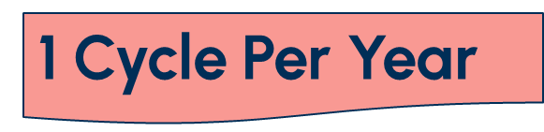
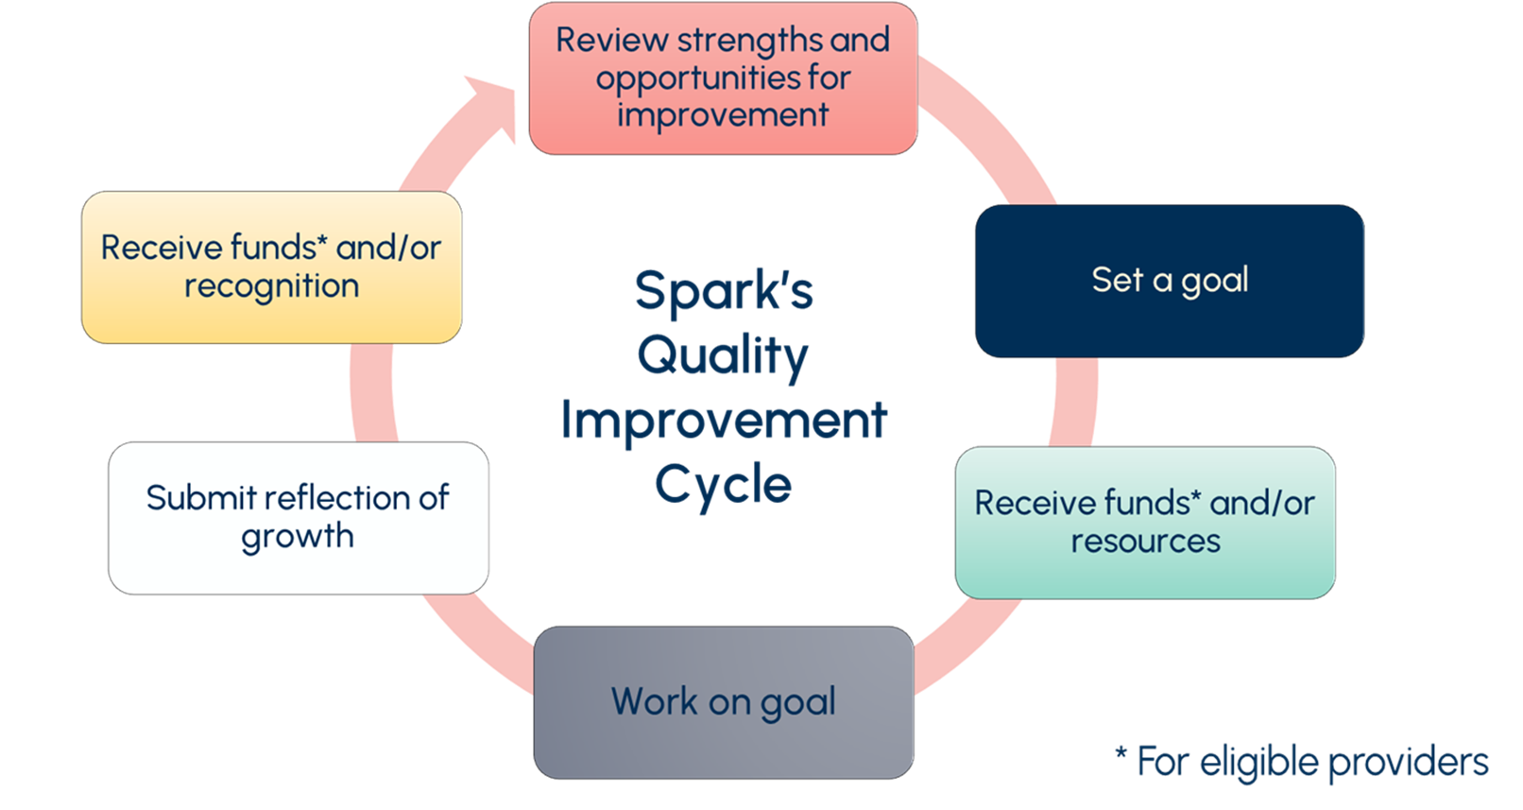
Spark programs can apply for an additional $5000
$250
$500
* For eligible providers & programs

Slide 4
PAUSE
Take a brief pause
Reflect on what was presented
Write down any questions you have and/or add them to the chat
Any Questions About:
What happens after June 30, 2026?
QI Cycle Funds?
Increased Goal Payments?

Slide 5
FCCN Participation Payments
Networks that started betweenJuly 1, 2023 and June 30th 2026:
  $1,250 for small programs (0-20)
  $1,500 for medium programs (21-49)
  $1,750 for large programs (50+)
  Limited to 1-2 payments per program lifetime
Retiring
Can be combined or "stacked" with other funding opportunities
  QI Cycle Funds + FCCN Participation Payments
  Available while funds last, may need to reassess
Notes:
Touching on TRI said before, with the now retiring structure programs can max out their participation in networks and their funding opportunities, But with the new structure programs can engage 1x a year for funds forever.
Reassessing stacking

Slide 6
PAUSE
Take a brief pause
Reflect on what was presented
Write down any questions you have and/or add them to the chat
Any Questions About:
What happens after June 30, 2026?
FCCN Participation Payments?
Allowable combinations?

Slide 7
Funding Type and Maximum Amount | Recipients
Quality Improvement (QI) Cycle Funds Goal Payment - $500 Reflection Payment -$750 . | Eligible Spark Programs and/or FCCN participants
Spark Increased Goal Payment -Up to $5,000 (More details will be available in June 2026.) | Eligible Spark Programs
FCCN Participation Payments Small Program (0-20 licensed capacity)-$1,250 Medium Program (21-49 licensed capacity)-$1,500 Large Program (50+ licensed capacity)-$1,750 | Eligible FCCN participants with network start dates between July 1, 2023, and June 30, 2026
If other eligibility requirements metand funds are still avaiable

Slide 8
Review
Question: When will the new Spark Funding Structure begin?
Answer: July 1, 2026
Question: Starting July 1, 2026 what funding opportunities will be offered through Spark to support quality improvements?
Answer:
QI Cycle Funds (Goal & Reflection Payments),
Spark Increased Goal Payments
FCCN Participation Payments ONLY If the network started before July 1, 2026*
Notes:
Additional criteria for FCCN PP still applies such as 2 cycle payments for the lifetime of the program

Slide 9
Review
Question: Can a program receive QI Cycle Funds from Spark but not be in Spark?
Answer: Yes, but only if they are in a Focused Child Care Network.
Question: Can an FCCN participant receive both QI Cycle funds and an FCCN Participation Payment?
Answer: Yes, but only if their network started before July 1, 2026 and meet other eligibility criteria.
Notes:
Additional criteria for FCCN PP still applies such as 2 cycle payments for the lifetime of the program

Slide 10
Review
Question: Can a program receive two QI Cycle funds in a year if they are in a network and in Spark?
Answer: No. Programs can only receive QI Cycle funds once per year.
Question: With Spark's New Funding Structure, how many times can network participants receive QI Cycle Funds?
Answer: There is no current limit besides once per year. These are meant to be ongoing.
Notes:
Additional criteria for FCCN PP still applies such as 2 cycle payments for the lifetime of the program

